Slide 1
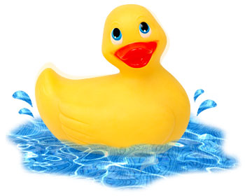
Simple Measurements & Buoyancy Force
1st year physics laboratories
University of Ottawa
https://uottawa.brightspace.com/d2l/home

Slide 2
SIMPLE MEASUREMENTS
The TA will go over the following tutorials.
Error calculations
There is a test on error calculations on the lab website.
You may complete the test as many times as you want until the deadline. Only your highest mark will be recorded.
How to use the following instruments:
Meter stick
Vernier caliper
Rounding and significant figures.

Slide 3
ERROR CALCULATIONS
Propagation of errors: addition and subtraction
If the result $R$ is obtained from a series of additions and subtractions:
$$R=± Ax±By±… ,$$
where $A$ and $B$ are constants, then the error on the result $R$ is given by $$∆R=\sqrt{A^{2}{∆x}^{2}+B^{2}{∆y}^{2}+…}$$
See tutorial – Propagation of errors pg. 1

Slide 4
ERROR CALCULATIONS
Propagation of errors: multiplication and division
If the result $R$ is obtained from a series of products: $R=x^{A}y^{B}⋯,$
where $A$ and $B$ are constants, then the error on the result $R$ is given by $$∆R=R\sqrt{A^{2}\frac{{∆x}^{2}}{x^{2}}+B^{2}\frac{{∆y}^{2}}{y^{2}}+…}$$
See tutorial – Propagation of errors pg. 2

Slide 5
REPEATED MEASUREMENTS
When dealing with multiple measurements, we use the statistical quantities: mean (or average), standard deviation, and standard error (SE) to interpret our data.
- The mean (or average) is an estimate of the “true” value of the measurement.
- The standard deviation is a measurement of the “spread” in your data. If you took one more measurement, you can be ~70% sure that this value will be one standard deviation away from your mean.
- The standard error is an estimate of the uncertainty in the mean value. If you repeated your experiment, you can be ~70% sure that the new mean will be one standard error away from your original mean.
See tutorial – Repeated Measurements

Slide 6
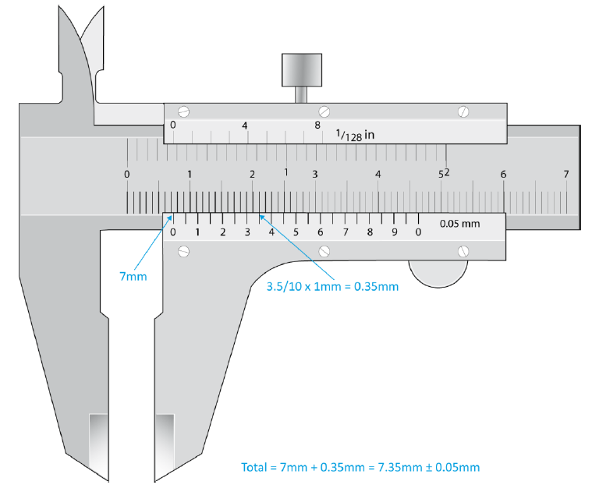
MEASURING INSTRUMENTS
See tutorial - Measuring techniques
Vernier caliper: for lengths between 1 cm and 10 cm

Slide 7
MEASURING INSTRUMENTS 3
Absolute uncertainties:
Meter stick: ± 0.5 mm (per reading)
Vernier caliper: ± 0.05 mm
Balance: ± 0.1 g
Stopwatch: ± 0.2 – 0.5 sec

Slide 8
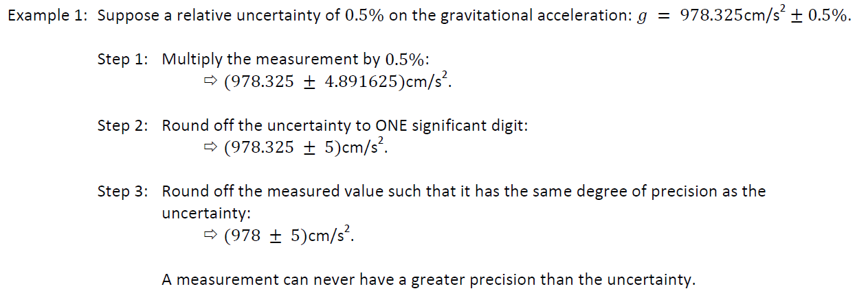
SIGNIFICANT FIGURES AND ROUNDING
See tutorial – Experimental errors pg. 6

Slide 9
LAB 1: OBJECTIVES
Part 1: Length measurement
Measure dimensions of an object to find its volume and calculate its density
Determine material type from a density table
Use uncertainty and perform error calculations
Part 2: Time measurement
Calculate the period of oscillation of a pendulum
Determine statistical quantities such as average, standard deviation, and standard error
Part 3: Investigate Archimedes’ principle regarding buoyant forces
Determine the value of the density of a liquid using a force sensor to measure the buoyancy of an object gradually being submerged in water.
Generate a graph of the buoyancy force vs. volume of displaced water and use a linear regression tool to determine the density of water.

Slide 10
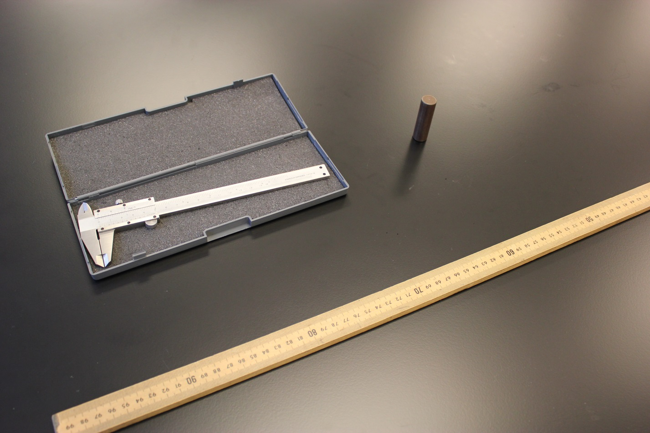
Part 1 - Length measurement
The instruments and the cylinder:
Solid cylinder
Vernier caliper
Meter stick

Slide 11
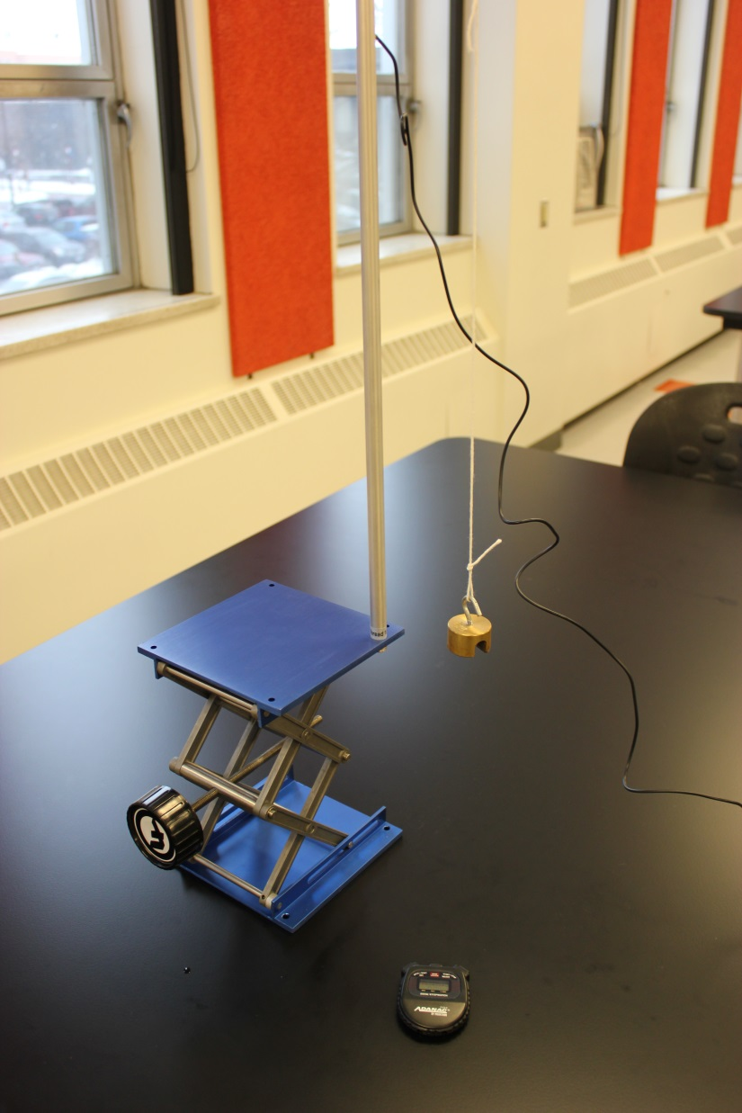
Part 2 - Time measurement
The pendulum:
100 g
Stopwatch

Slide 12
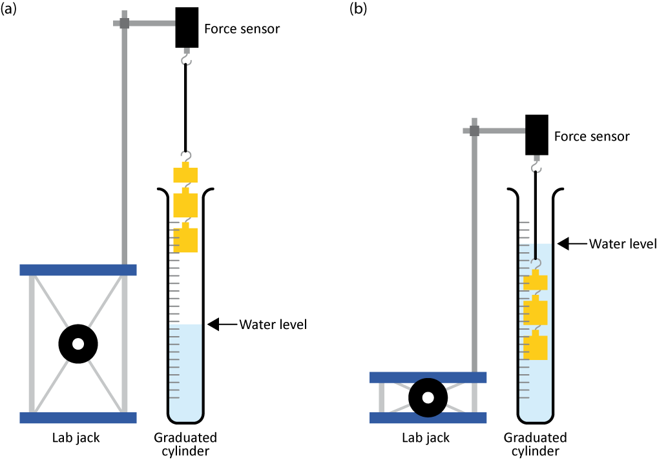
BUOYANCY FORCE
The buoyant force, $F_{b}$, exerted on an object partially or fully submerged in a fluid is equal to the weight of the displaced fluid: $F_{b}=ρVg$
Use a force sensor to measure $Fb$ experienced by an object gradually immersed in water.
Make a plot of $Fb$ vs. $V$ then use a linear regression to find $ρ$.

Slide 13
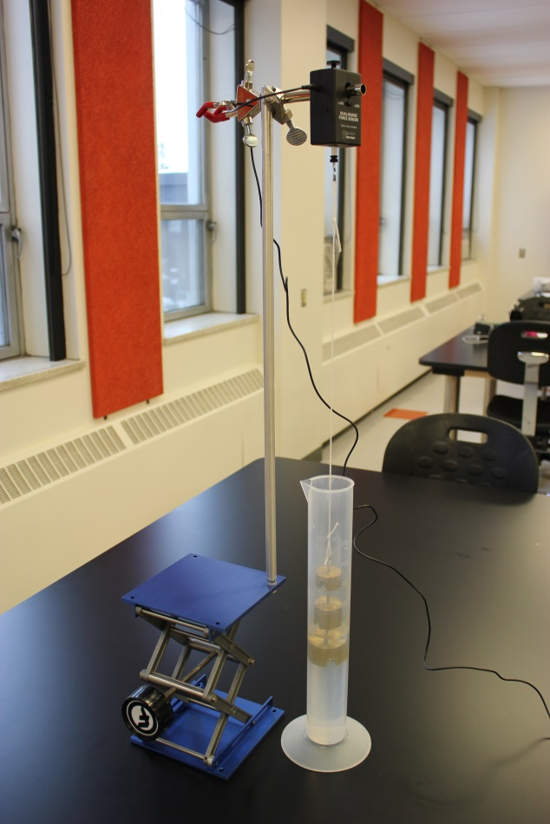
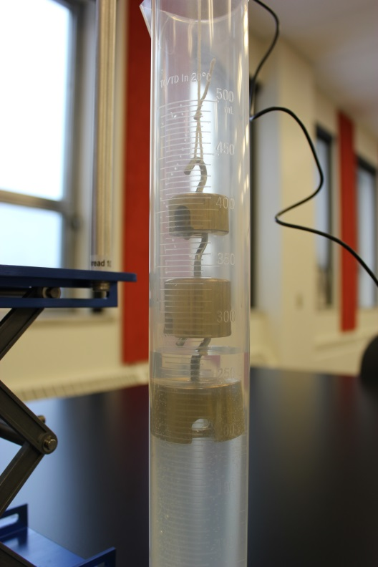
Part 3 – Buoyancy force setup
The setup:
A closer look:
Force sensor
Graduated cylinder and immersed masses
Lab jack

Slide 14
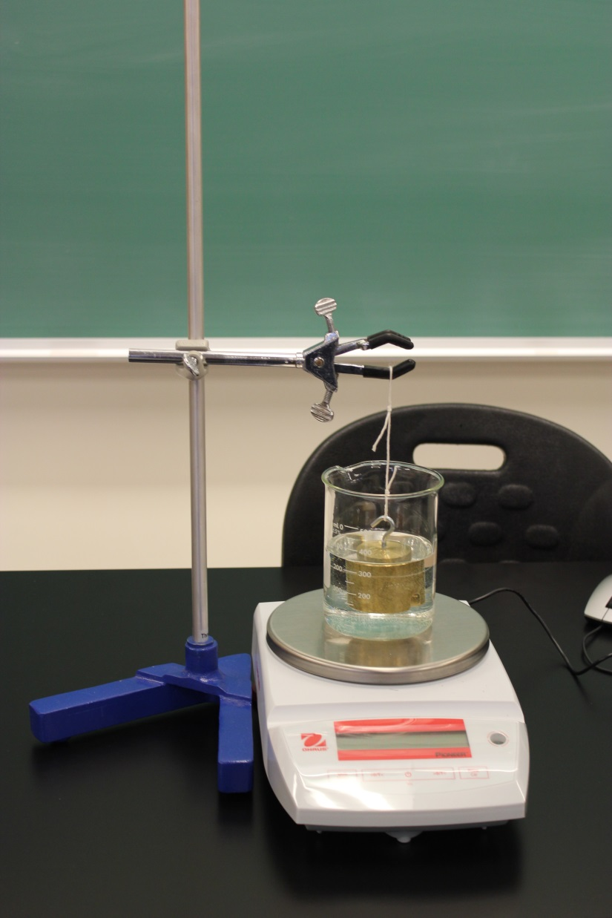
Buoyancy force setup (cont.)
A 500 g mass will be suspended in water over an electronic balance.
Your TA will set up this part. The balance will first be zeroed with only the beaker and water. Then the mass will be submerged in the water and you will record the reading on the balance.

Slide 15
CLEAN UP
Turn off the computer. Don’t forget to pick up your USB key if you used one!
Throw away the water in your graduated cylinder in the sink in front of the classroom. Let your cylinder dry near the sink. Use brown paper to dry the suspended masses (they will rust!).
Your kind TA will clean up the setup at the front of the class for the 500 g mass submerged in the beaker on the balance.
Recycle scrap paper and throw away any garbage. Leave your station as clean as you can.
Push back the monitor, keyboard and mouse. Also please push your chairs back under the table.

Slide 16
DUE DATE
REMINDER: Exp. 0!
Do the 4 tests in Exp. 0 folder before the deadline!
The report is due in 1 week.
The dropbox is located in the central corridor of STM 3rd floor south tower. See the section on Brightspace “Lab report dropbox” for more instructions on how to find it.
Please make sure you put your report in the correct dropbox!
PRE-LAB
Don’t forget to do your pre-lab for Exp. 2! Don’t wait until the last minute, there will be no extension or make-up for students experiencing technical problems a few minutes before the deadline!!
Notes:
Comments for TAs: leave this slide on the TV monitors when you are not using them for teaching.

