Slide 1
Simple Measurements
& Free fall
1st year physics laboratories
University of Ottawa
https://uottawa.brightspace.com/d2l/home

Slide 2
SIMPLE MEASUREMENTS
The TA will go over the following tutorials.
Error calculations
  There is a test on error calculations on the lab website.
  You may complete the test as many times as you want until the deadline. Only your highest mark will be recorded.
How to use the following instruments:
  Meter stick
  Vernier caliper
Rounding and significant figures.

Slide 3
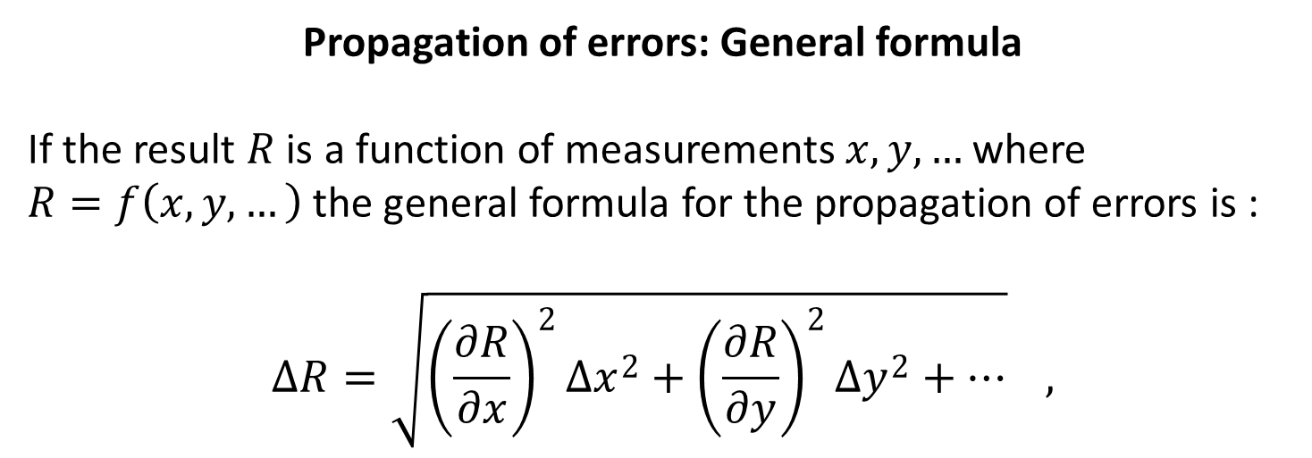
ERROR CALCULATIONS
Propagation of errors: General formula
If the result $R$ is a function of measurements $x,y, …$ where
$R=f\left(x, y,…\right)$ the general formula for the propagation of errors is :
$$∆R=\sqrt{{\left(\frac{∂R}{∂x}\right)}^{2}{∆x}^{2}+{\left(\frac{∂R}{∂y}\right)}^{2}{∆y}^{2}+…} ,$$
See tutorial – Propagation of errors pg. 1

Slide 4
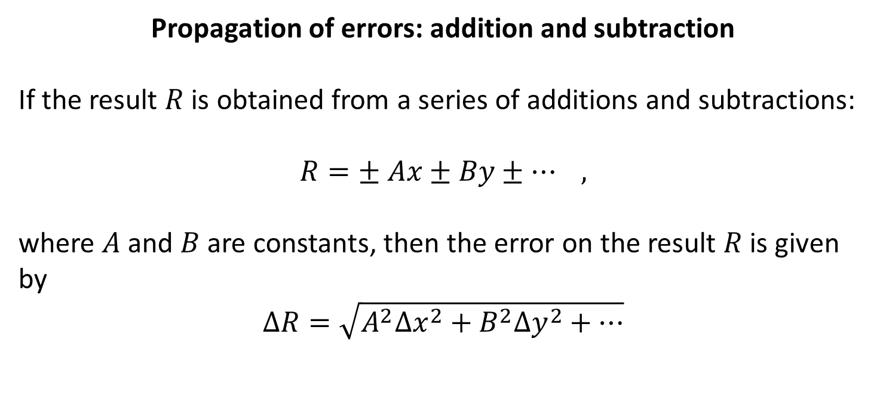
ERROR CALCULATIONS
Propagation of errors: addition and subtraction
If the result $R$ is obtained from a series of additions and subtractions:
$$R=± Ax±By±… ,$$
where $A$ and $B$ are constants, then the error on the result $R$ is given by
$$∆R=\sqrt{A^{2}{∆x}^{2}+B^{2}{∆y}^{2}+…}$$
See tutorial – Propagation of errors pg. 1

Slide 5
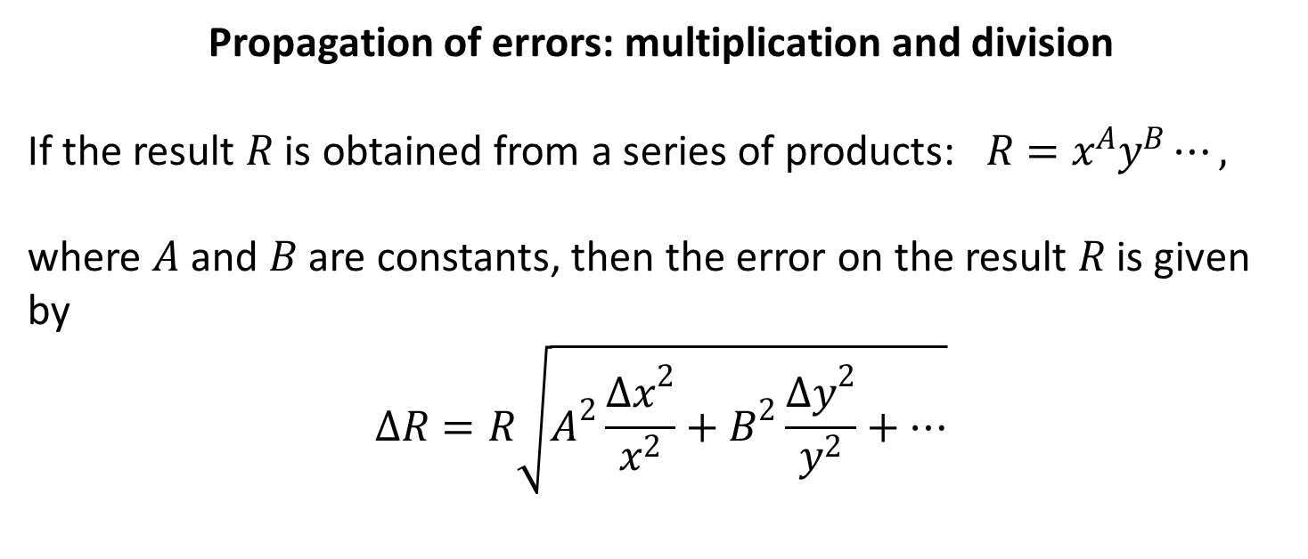
ERROR CALCULATIONS
Propagation of errors: multiplication and division
If the result $R$ is obtained from a series of products: $R=x^{A}y^{B}⋯,$
where $A$ and $B$ are constants, then the error on the result $R$ is given by
$$∆R=R\sqrt{A^{2}\frac{{∆x}^{2}}{x^{2}}+B^{2}\frac{{∆y}^{2}}{y^{2}}+…}$$
See tutorial – Propagation of errors pg. 2

Slide 6
REPEATED MEASUREMENTS
When dealing with multiple measurements, we use the statistical quantities: mean (or average), standard deviation, and standard error (SE) to interpret our data.
- The mean (or average) is an estimate of the “true” value of the measurement.
- The standard deviation is a measurement of the “spread” in your data. If you took one more measurement, you can be ~70% sure that this value will be one standard deviation away from your mean.
- The standard error is an estimate of the uncertainty in the mean value. If you repeated your experiment, you can be ~70% sure that the new mean will be one standard error away from your original mean.
See tutorial – Repeated Measurements

Slide 7
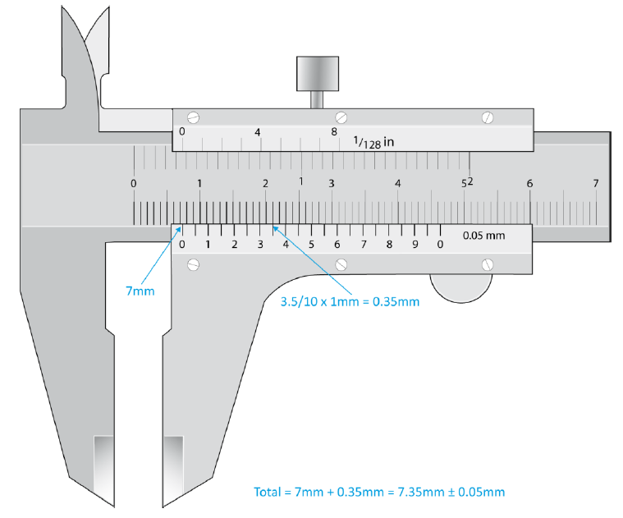
MEASURING INSTRUMENTS
See tutorial - Measuring techniques
Vernier caliper:
for lengths between
1 cm and 10 cm

Slide 8
MEASURING INSTRUMENTS
Absolute uncertainties:
Meter stick: ± 0.5 mm (per reading)
Vernier caliper: ± 0.05 mm
Balance: ± 0.1 g
Stopwatch: ± 0.2 – 0.5 sec

Slide 9
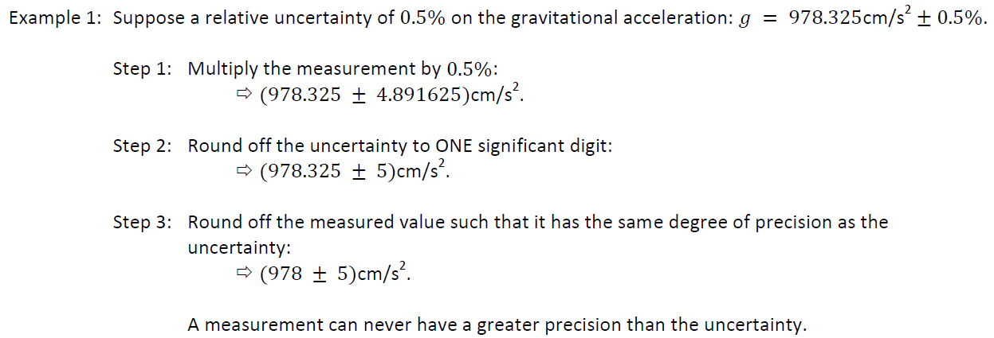
SIGNIFICANT FIGURES AND ROUNDING
See tutorial – Experimental errors pg. 6

Slide 10
LAB 1: OBJECTIVES
Part 1: Length measurement
  Measure dimensions of objects to calculate their volume and density
  Determine material type from a density table
  Use uncertainty and perform error calculations
Part 2: Time measurement
  Measure the period of oscillation of a mass-spring system
  Determine statistical quantities such as average, standard deviation, and standard error
Part 3: Picket fence free-fall
  Use automated data acquisition to determine velocity of a free-falling object.
  Generate a graph of velocity vs. time for the object and use a linear regression tool to determine the gravitational acceleration constant, g.

Slide 11
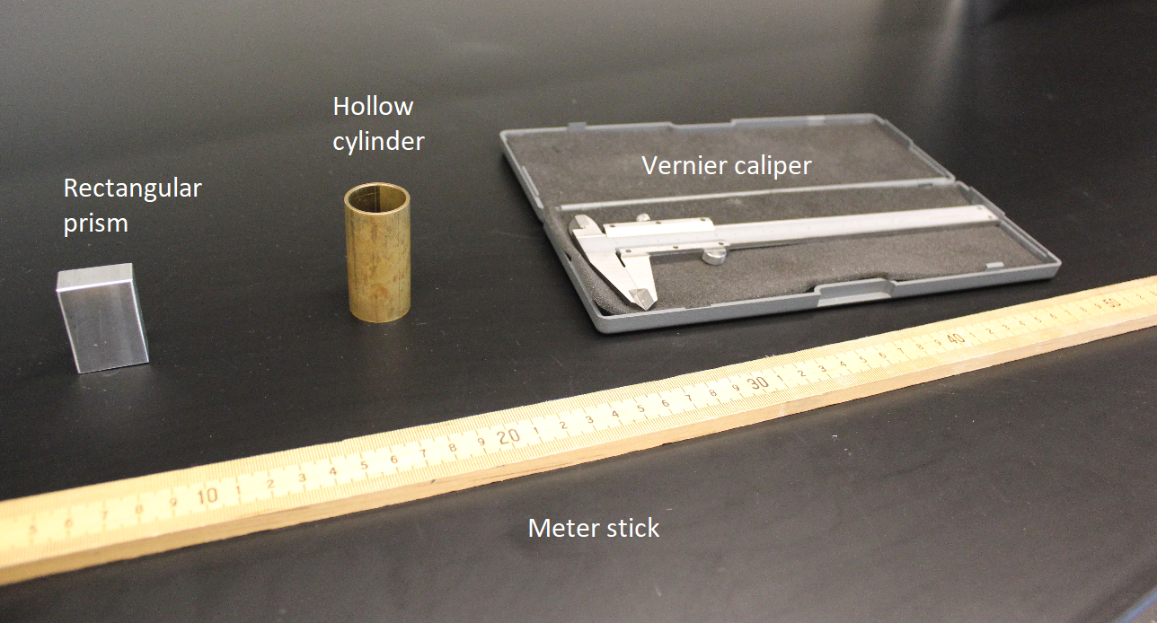
Part 1 - Length measurement
The objects and instruments:
Meter stick
Meter stick
Micrometer
Micrometer
Vernier caliper
Vernier caliper

Slide 12
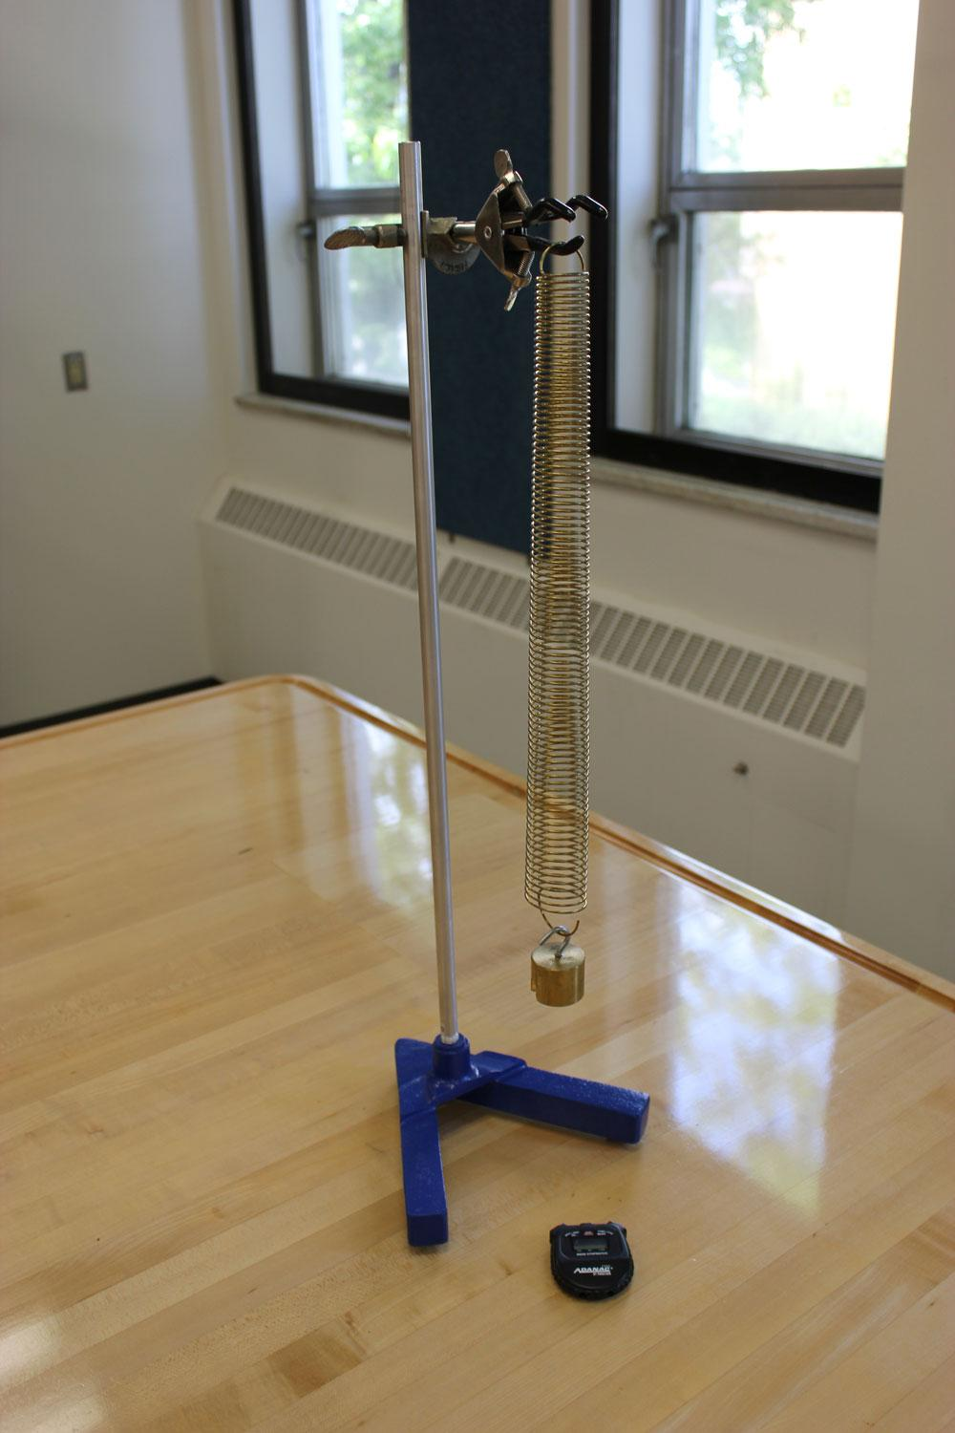
Part 2 - Time measurement
The mass-spring system:
Record the period of oscillation for the 200 g mass on the spring.
Spring
Mass (200 g)
Stopwatch

Slide 13
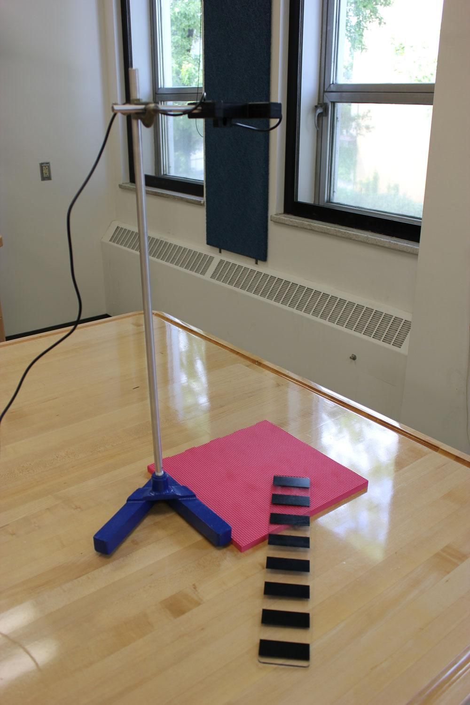
Part 3 - Picket fence free fall
The setup:
Record velocity and time data for the picket fence falling through the photogate.
Photogate
Foam mat
Picket fence

Slide 14
CLEAN UP
Turn off the computer.
Don’t forget to pick up your USB key if you used one!
Put back the objects and measuring instruments all together neatly on your table.
Recycle scrap paper and throw away any garbage. Leave your station as clean as you can.
Push back the monitor, keyboard and mouse. Also please push your chairs back under the table.

Slide 15
DUE DATE
REMINDER: TESTS!
Do the 4 tests in Exp. 0 folder before the due date!
The report is due in one week before 5 pm (for fall/winter). (Spring: 4:00 pm!)
Please drop off your report in the LAB dropoff box located in the central corridor of STEM 3rd floor, south tower.
PRE-LAB
Don’t forget to do your pre-lab for Exp. 2!
Don’t wait until the last minute, there will be no extension for students experiencing technical problems a few minutes before the deadline!!
NEXT LAB
Your next lab is not a take-home! It will be due at the end of the lab session!
Notes:
Comments for TAs: leave this slide on the TV monitors when you are not using them for teaching.

