Slide 1
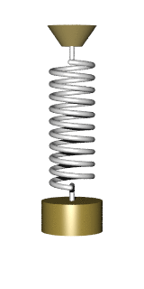
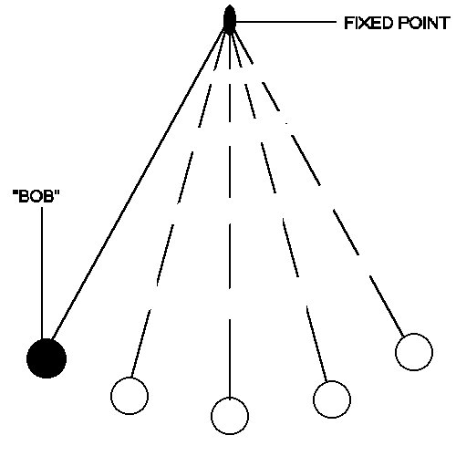
Simple Harmonic Motion
1st year physics laboratories
University of Ottawa
https://uottawa.brightspace.com/d2l/home

Slide 2
INTRODUCTION
A mass on a spring will oscillate in simple harmonic motion (SHM). In this experiment you will investigate this type of motion where an object moves back and forth along a fixed path.
If a mass on a spring is pulled down then released, the spring exerts a restoring force, $\vec{F}=−k\vec{x}$, where $\vec{x}$ is the distance the spring is displaced and $k$ is the “spring constant” of your spring.

Slide 3
INTRODUCTION (cont.)
For a mass oscillating in SHM on an ideal spring (spring has no mass), the period, T, is given by $T=2π\sqrt{\frac{m}{k}} .$
If the spring has mass, the corrected equation for the period is: $T=2π\sqrt{\frac{m+{γm}_{s}}{k}}$
where $m_{s}$ is the mass of the spring and $γ$ is a constant between 0 and 1 which depends on the type of spring used.
For a regular uniform spring, $γ$ is equal to 1/3. You will determine the $γ$ value for the conical harmonic motion spring you will use in this experiment.

Slide 4
OBJECTIVES
Collect position vs. time data for a mass oscillating in SHM on a hanging conical spring and determine the best fit equation for the position vs. time graph.
Relate the variables in your best fit equation to the physical parameters in your system.
Compare the force constant of your spring obtained by static measurements with that found using dynamic measurements.
Estimate the spring’s correction factor, $γ$, to calculate the effective mass of your spring.

Slide 5
SAFETY WARNING!
Never hang masses above the motion detector without using the motion detector guard (cage).
Dropping a mass on the detector could cause serious damage to it.
Please do not overstretch the spring beyond its elastic limit.
You need only use small amplitude oscillations (a few cm).
Always find an equilibrium point for your mass on the spring and pull gently to start the oscillations.
Please do not let the masses fall from an arbitrary height to begin oscillations.

Slide 6
PRELIMINARY WORK
Both the force and motion sensors should be connected to your Labquest Mini device. In Logger Pro you should see values for force and position.
The motion detector should be set to “track” and the force sensor set to “10 N”.
Prepare the setup as shown in Fig. 1 (next slide).
Put 300 g on the mass hanger and let it equilibrate, then zero both your sensors.
Collect position vs. time and force vs. time data and fit your curves with a sinusoidal function: A*sin(B*t+C)+D

Slide 7
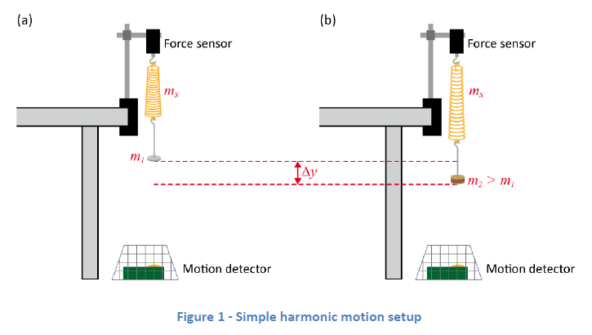
The setup

Slide 8
The setup (cont.)

Slide 9
Small Amplitude Oscillations

Slide 10
$k$ from static measurements
Start with an empty mass hanger and zero both your sensors.
Add 100 g to the spring and let it settle. Record the new position, $∆y$, and start filling in Table 2.
Record the new position as you add mass to the hanger, 100 g at a time.
Prepare your plot of extending force ($F=mg$) vs. position ($∆y$).

Slide 11
$k$ from dynamics measurements
We start with the equation for the period of oscillation and square it: $T=2π\sqrt{\frac{m+{γm}_{s}}{k}}$ → $T^{2}=\frac{4π^{2}m}{k}+\frac{4π^{2}γm_{s}}{k} .$
Record position vs. time data for small oscillations of the mass hanger and 100 g on the spring.
Perform a sinusoidal fit of your data and start filling in Table 3. Recall that B is the angular frequency ($ω$) of the oscillation.
Record new position vs. time data as you add mass to the hanger, 100 g at a time. Complete Table 3.
Prepare your graph of T² vs. m. (Recall $T={2π}/ω$).

Slide 12
Investigating Amplitude vs Frequency.
Put 300 g on the mass hanger.
Collect data for different amplitudes of oscillation (different values of $∆y$) between 0.01 to 0.1 m.
Perform a series of sinusoidal fits for your different runs.
Note the A (amplitude) and B (frequency) values for your different sinusoidal fits and complete Table 4.

Slide 13
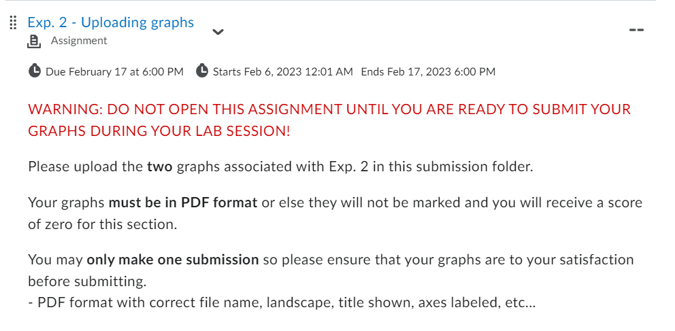
GRAPHS
There are two graphs to create and submit for this lab. Use the “Uploading graphs” tool at the bottom of the experiment page in Brightspace.

Slide 14
CLEAN UP
DUE DATE
Turn off the computer and don’t forget to take your USB key.
Replace the masses, mass hanger, spring, motion detector, and cage back on the table.
Please recycle scrap paper and throw away any garbage. Please leave your station as clean as you can.
Push back the monitor, keyboard, and mouse. Please push your chair back under the table.
Thank you!
The report is due at the end of the lab session.
Don’t forget to do your pre-lab for the next experiment!
PRE-LAB

