Slide 1
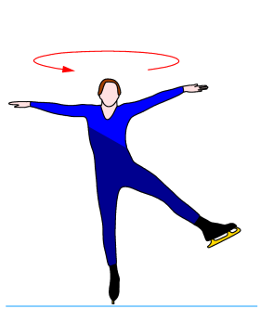
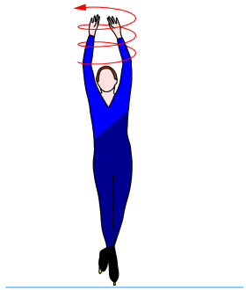
Exp. 5: Rotational Dynamics
1st year physics laboratories
University of Ottawa
Fall 2014
https://uottawa.blackboard.com/

Slide 2
INTRODUCTION
Newtonian dynamics tells us that net force is proportional to acceleration F = ma.
For an object that is free to rotate, consider the rotational analogue: τ = Iα
The moment of inertia for a cylinder is given by:
where M and R are the mass and the radius of the cylinder.
torque = moment of inertia × angular acceleration
I = MR² / 2

Slide 3
INTRODUCTION
In-class lab due at end of session (12:50 or 5:20pm)
Logger Pro templates available on Blackboard Learn
2 graphs to submit online (PDF format)

Slide 5
INTRODUCTION (part 1)
We can experimentally determine the moment of inertia of an object by applying a known torque and measuring the angular acceleration.
You will apply a series of torques to a disc and measure corresponding angular accelerations.
  You will make a plot to graphically determine the moment of inertia.

Slide 6
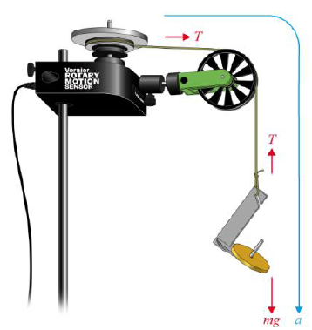
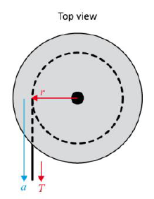
INTRODUCTION (part 1 cont.)
The rotational sensor measures θ vs t.
You will measure angular accelerations for different torques
  Angular speed: ω = dθ/dt
  Angular acceleration:
  α = dω/dt
We use a hanging mass so torque is:
τ = rT (T is tension)
For the acceleration of the hanging mass:
mg – T = ma
(a is acceleration of mass)
- We solve for T: τ = rT = mr(g – a) = mr(g – αr)

Slide 7
INTRODUCTION (part 2)
Similar to the linear momentum experiment, you will investigate how the angular momentum of a rotating system is affected by a change in the moment of inertia.
You will measure the angular speed of a rotating disc before (ω) and after (ωˊ) a completely inelastic collision.
The equation to calculate the angular momentum before and after the collision is:
L = I₁ω = Lˊ = I₁ωˊ + I₂ωˊ

Slide 8
OBJECTIVES
Part 1:
Collect α for various τ (three objects)
Experimentally determine I for an object
Part 2:
Measure ω before and after a collision to see how a change in I affects L.

Slide 9
PART 1 – Moment of Inertia
Record the diameter of the large pulley and the mass and diameter of the first aluminum disc.
Attach a string to the edge of the large pulley on the sensor and hang it over the green pulley. Attach the mass hanger to the end of the string.
  Make sure the mass hanger is close to but not touching the ground.
Wind the large pulley and collect data (5 s) as the mass hanger accelerates the aluminum disc.
To determine the angular acceleration of the disc, perform a linear fit on the ω vs t graph.
Repeat the measurement for increasing masses.

Slide 10
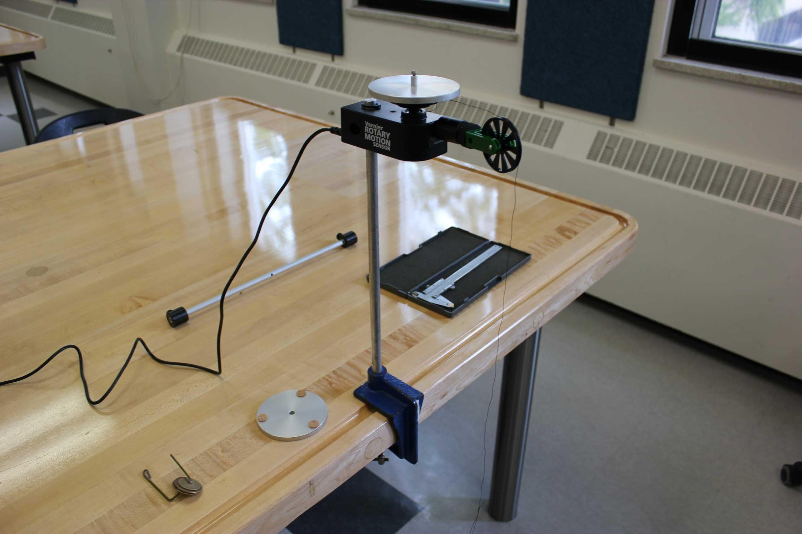
The setup for rotating discs

Slide 11
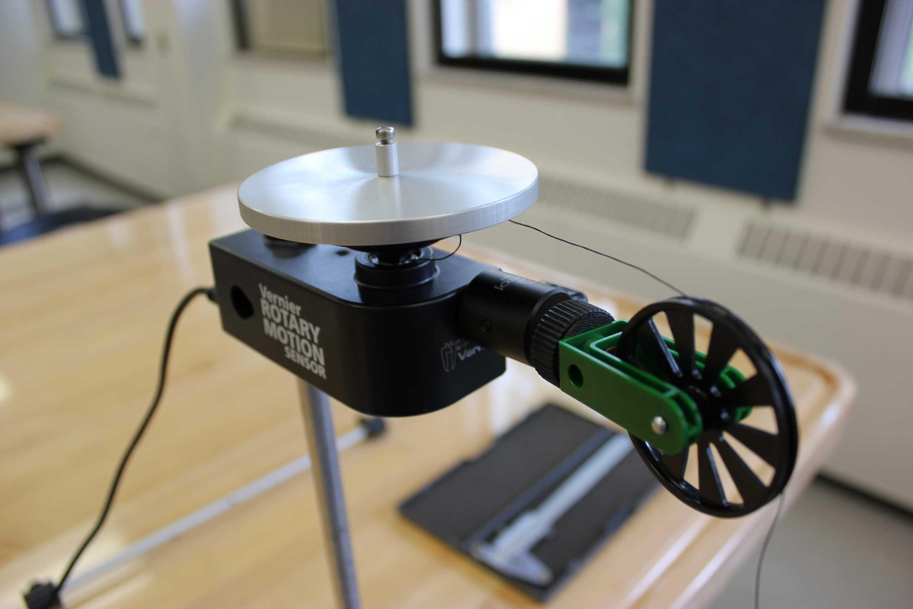
A Closer Look…

Slide 12
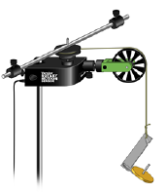
PART 1 – Moment of Inertia (cont.)
Find the mass of the second aluminum disc (the one with cork padding).
Repeat the experiment with both aluminum discs attached to the sensor.
Find the masses of the rod and weights
then attach them to the sensor.
Repeat the experiment for the rod and
weights (use 20 s collection).

Slide 13
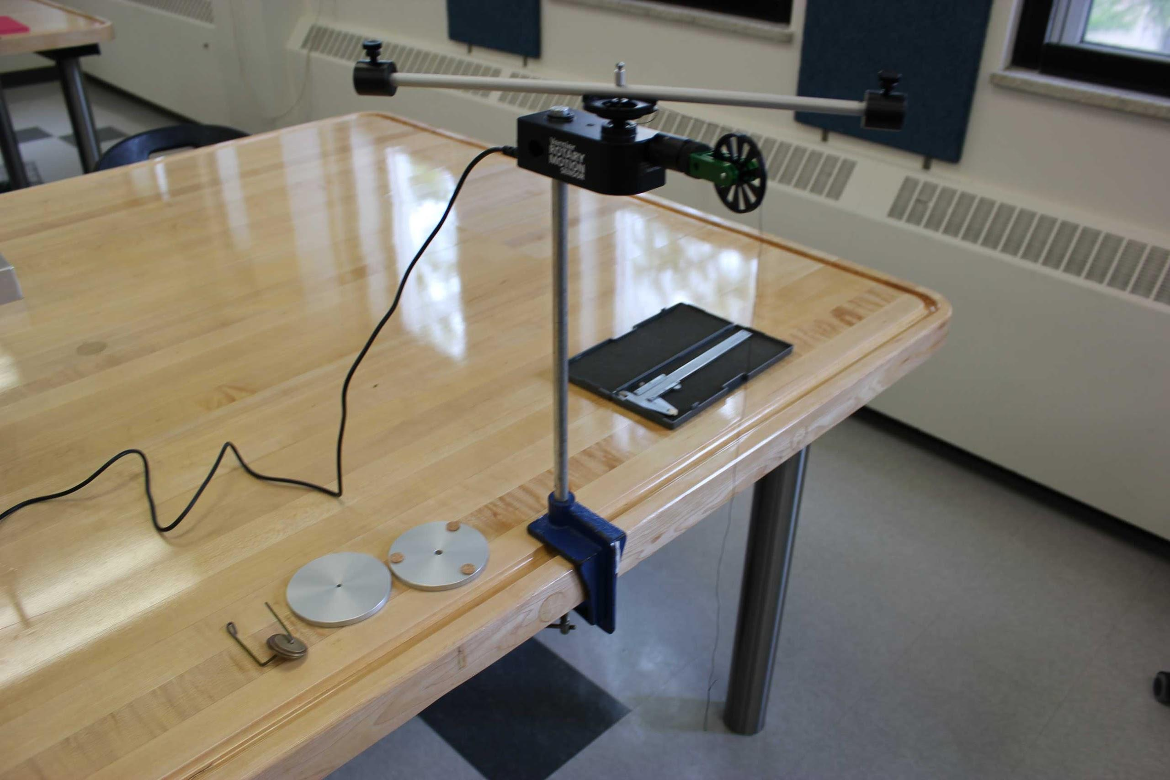
The setup for rotating rod and masses

Slide 14
PART 1 – Moment of Inertia (cont.)
You will make a plot of τ vs α for the three data sets you collected.
Perform a linear regression on each data set to determine your experimental values for the moments of inertia of the three systems.
Recall our formula that relates τ and α.
τ = mr(g – αr)

Slide 15
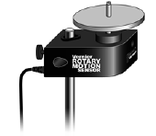
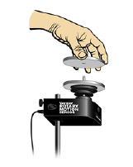
PART 2 – Conversation of Angular Momentum
Mount your first aluminum disc to the pulley (same as first section of Part 1).
Spin the first disc. You’ll notice the velocity decreasing gradually.
Position the second disc over the screw and practice dropping it onto the first.
Collect the angular velocity data of the system before (ω) and after (ωˊ) the collision.
  Using your graph of ω vs t, calculate whether the total momentum of the system was conserved.

Slide 16

CLEAN UP
DUE DATE
Turn off the air supply, computer, and don’t forget to take your USB key.
Put the discs, rod, and weights on the table.
Please recycle scrap paper and throw away any garbage. Please leave your station as clean as you can.
Push back the monitor, keyboard, and mouse. Please push your chair back under the table.
Thank you!
The report is due at the end
of the lab session, i.e., at 12:50pm or 5:20pm.
You are about to complete your last physics lab for this semester!
Notes:
Comments for TAs: leave this slide on the TV monitors when you are not using them for teaching.

