Slide 1
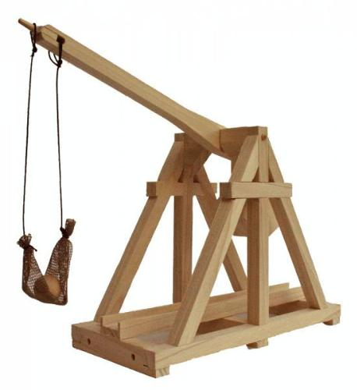
Projectile motion
1st year physics laboratories
University of Ottawa
https://uottawa.blackboard.com/

Slide 2
INTRODUCTION
NOTES:
In-class lab (due at 5:20pm or 12:50pm)
No graph to submit
Can be long, multiple parts, keep students on task
Give presentation/demonstration at beginning
Explain theory and show how the equipment works!

Slide 3
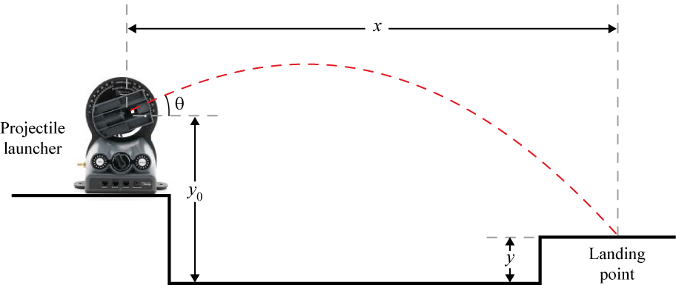
PROJECTILE RANGE
We can separate the equation of motion for a projectile launched at an angle θ into its x and y coordinates:
$y=y_{0}+\left(v_{0}\sin{θ}\right)t−\frac{1}{2}gt^{2}$ $t=\frac{2v_{0}\sin{θ}}{g}$
$x=\left(v_{0}\cos{θ}\right)t$

Slide 4
GOAL
1) Initial velocity and average (use Excel)
2) Calculate time of flight then measure and average (use Excel) for $y=0$(height at 0.146m)
3) Challenge (calculate $x$)
4) Conservation of energy

Slide 5
CHALLENGE
Set the height of target (between 20 and 25 cm)
Set the angle of launcher (between 50° and 70°).
Take the student’s ball
Student will calculate $x$
When student is ready, give them the ball and let them shoot 3 times
NO PRACTICE SHOTS ALLOWED

Slide 6
CONSERVATION OF ENERGY
When a projectile is shot straight up,
$U_{0}=0$ and $K_{0}=\frac{1}{2}mv_{0}^{2}$
When the projectile reaches its max. height (h)
$U=mgh$ and $K=0$
Use $\frac{1}{2}mv_{0}^{2}=mgh$ and solve for $h$ and compare.

Slide 7
SAFETY CONSIDERATIONS
SAFETY GOGGLES
FOAM PAD

Slide 8
THE FULL SETUP
Wooden box
Foam mat
Time of flight pad
Launcher

