Slide 1
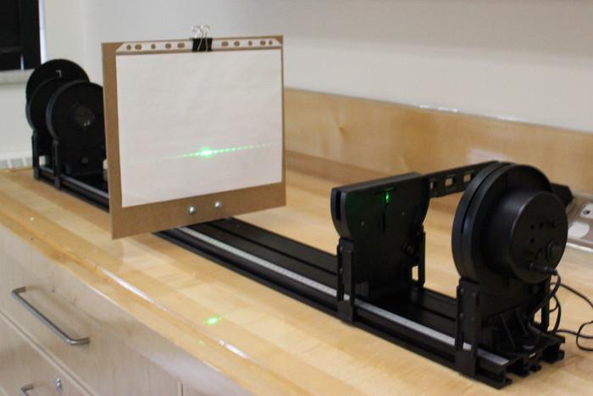
3.1 Single slit vs. double-slit

Slide 2
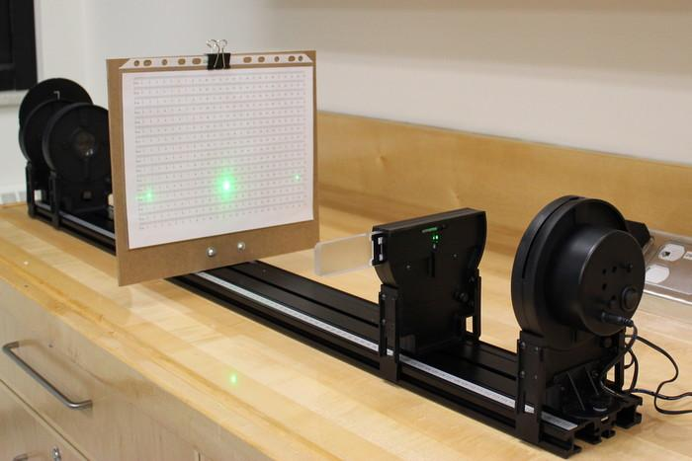
3.2 Diffraction gratings

Slide 3
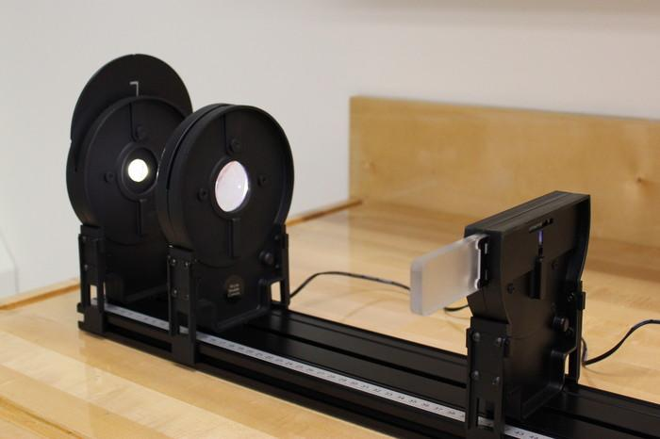
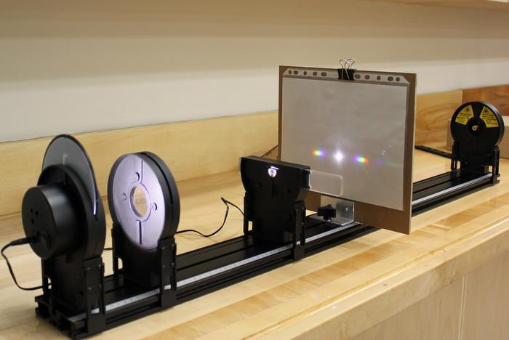
3.3 The spectrum of white light

Slide 4
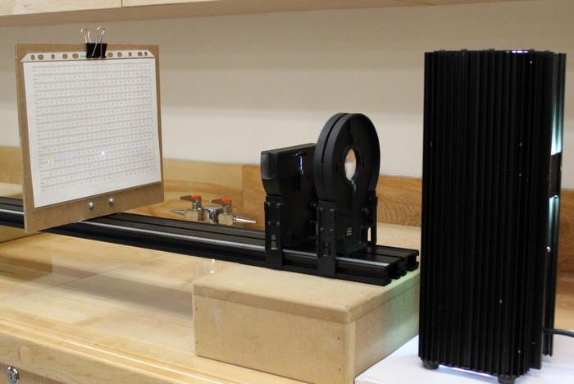
3.4 The spectrum of the mercury lamp

Slide 5
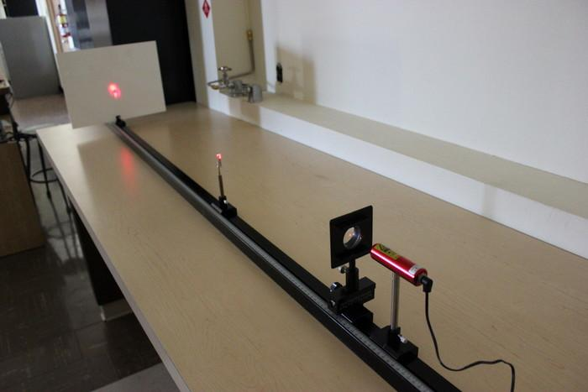
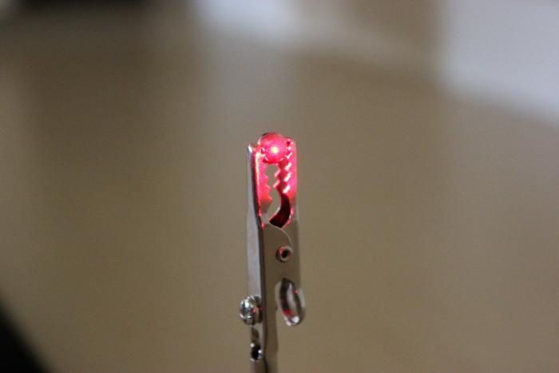
3.5 Diffraction around an obstacle

Slide 6
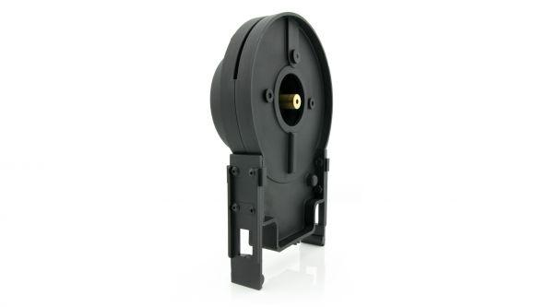
Equipment information: the laser
Your setup includes a red or green laser.
Red laser: wavelength of 636 nm.
Green laser: wavelength of 532 nm.
Laser Safety
This is a class 2 laser product.
Do not stare directly into the laser beam or its reflection.
Maximum output is < 1 mW.
A class 2 laser is generally considered safe as the blink reflex will limit exposure to short time periods. Most laser pointers are in this class. Direct exposure on the eye by a beam of laser light should always be avoided with any laser, no matter how low the power.

Slide 7
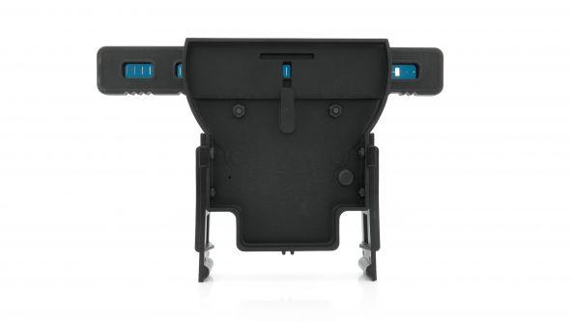
Equipment information: the slit assembly
Single slits | Variable slits | Double slits | Variable double slit | Multiple slits | Comparisons
• 0.02 mm • 0.04 mm • 0.08 mm • 0.16 mm | • Wedge: 0.02 – 0.2 mm wide • Double Slit: 0.04 mm wide, spacing 0.125 – 0.75 mm | • 0.04 mm wide, 0.25 mm apart • 0.04 mm wide, 0.5 mm apart • 0.08 mm wide, 0.25 mm apart • 0.08 mm wide, 0.5 mm apart | Same as variable slits | 4 sets: • 2, 3, 4, 5 slits • 0.04 mm wide at 0.25 mm apart | 4 pairs of single/double slits: • 0.04 mm single + 0.04/0.25 mm double, • doubles 0.04/0.25mm + 0.04/0.50 mm, • doubles 0.04/0.25 mm + 0.08/0.25 mm, • double 0.04/0.25 mm + triple, 0.04/0.25 mm

