Slide 1
Motion on a linear air track
1st year physics laboratories
University of Ottawa
https://uottawa.brightspace.com/d2l/home

Slide 2
INTRODUCTION
1) How the acceleration of a glider on an inclined air track is dependent on the angle of incline.
2) Study the motion of a glider under a constant force to investigate Newton’s second law of motion.
In both parts you will experimentally determine the acceleration due to gravity.

Slide 3
PART 1 – Inclined plane
Measure speed and acceleration of a glider down an incline for varying (small) angles and record your results in a table.
Using simply geometry, determine the relationship (equation) between the angle of incline and acceleration.
Plot a graph and use the fit parameters to experimentally determine the free fall acceleration, $g$.

Slide 4
PART 2 – Investigating Newton’s second law
Measure speed and acceleration of a glider as it is accelerated down a track by a hanging mass.
Identify the relationship between acceleration and the net force applied. Extrapolate the data to determine a 2nd value for free fall acceleration, $g$.
Determine the effect of the mass on the relationship between acceleration and force in your system.

Slide 5
The air track setup
Air supply
Air track

Slide 6
The setup (close-up)
Motion detector
Glider

Slide 7
PRELIMINARY TASKS
Launch Logger Pro, turn on the air supply (note, you are sharing the supply!), adjust the air flow.
Level your track using the adjustable legs.
Insert a 1 cm disc under the front leg of the track.
Collect position and velocity data as you launch the glider from the bottom of the track so that it slows to a stop about 1 m from its initial position before it returns.
Analyze the graphs of position and velocity vs. time and answer the questions in your laboratory report.

Slide 8
Simple motion on an incline
Launching the glider:

Slide 9
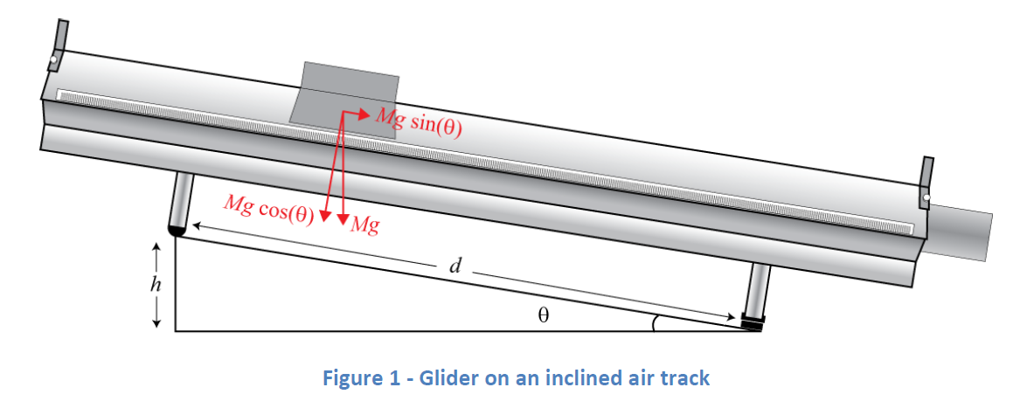
PART 1
Vertical force (pointing down) is $F=Mg$, where M is mass of glider and $g$ is the gravitational acceleration.
Acceleration force along the incline is $Ma=Mg\sin{θ} \left(1\right)$
The geometry of the track shows: $\sin{θ}=h/d \left(2\right)$ .
Using $\left(1\right)$ and $\left(2\right)$ we have the relation: $\boxed{a=g\frac{h}{d}}$ .

Slide 10
Part 1 – Determining g on an incline
The aluminum dics:

Slide 11
PART 1 (steps)
1) Measure the thicknesses of the aluminum discs using the vernier caliper (used to calculate $h$).
2) With the 1 cm disc under the leg of the track, record the position and velocity data of the glider as it slides down the incline. The slope in the velocity graph should be constant.
3) Use a linear regression to determine the slope (and its uncertainty) of the velocity graph. This is the acceleration of the glider.
4) Repeat the trial twice using the same height then increase the height by 1 cm and repeat steps 2-4.

Slide 12
PART 1 (analysis)
Prepare a graph of $a$ vs. $\sin{θ} \left(=h/d\right)$
Note that $d=1 m$ for this air track (the distance between the track’s legs).
Perform a linear regression showing the slope of the graph along with its uncertainty.
The slope of your graph will be your experimental value for the acceleration due to gravity. $a=g \frac{h}{d}$
$y$ axis
slope
$x$axis

Slide 13
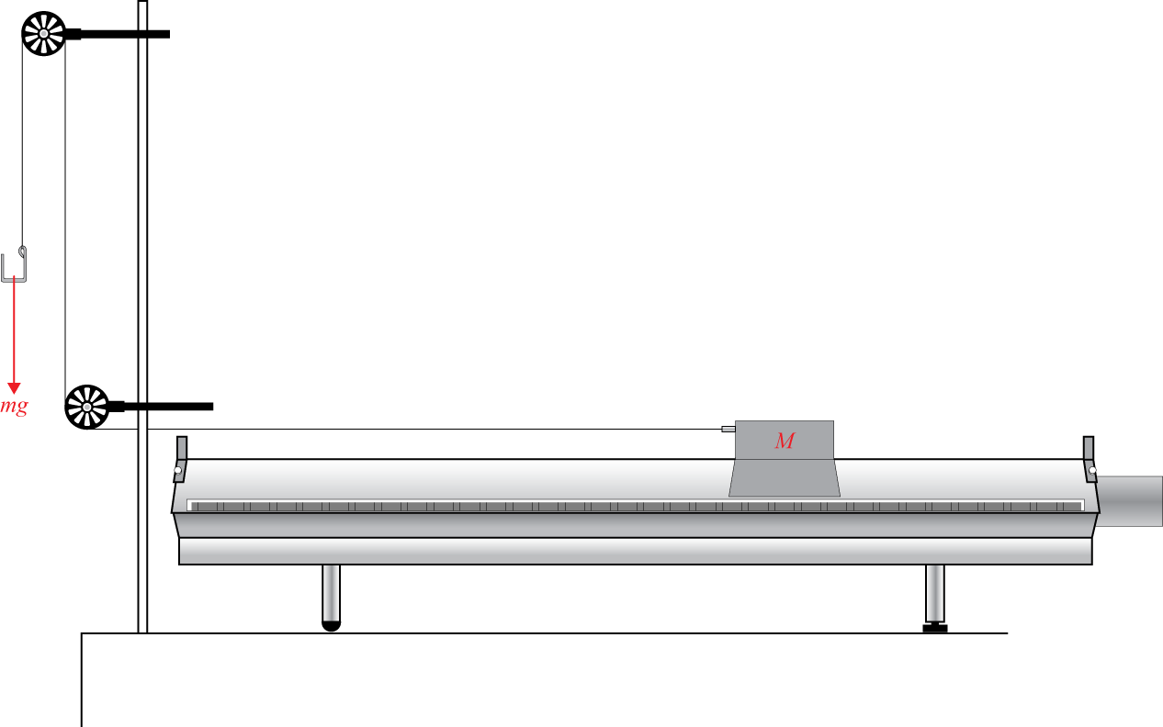
PART 2
The force on the glider is $F=mg=\left(M+m\right)a$ where $M$ is the mass of the glider and $m$ is the falling mass (plus the hook!).
We can determine the acceleration due to gravity by finding the slope of a graph of $a$ vs. $m/\left(M+m\right)$.

Slide 14
PART 2 (steps)
We use a level track for this part (no spacer).
1) Measure the masses of the glider/hook/falling masses.
2) Connect the string to the glider and loop it through the two pulleys then connect the hook to the string. The hook should hang ∼2 cm from the ground when the glider is at the end of the track (near the pullies).
3) Collect data as the glider accelerates from one end of the track to the other the falling mass.
4) Repeat each trial twice before increasing the falling mass by 5 g. You should use up to 25 g on the hook.

Slide 15
Part 2 – Investigating Newton’s second law
The pulleys and the
hook for masses:
The glider with attachment:

Slide 16
PART 2 (analysis)
Create a graph of acceleration of the glider as a function of $m/\left(M+m\right)$.
You will need to calculate $m/\left(M+m\right)$ for each falling mass that was used.
Perform a linear regression showing the slope of the graph along with its uncertainty.
The slope of your graph will be your second experimental value for the acceleration due to gravity. $a=g\frac{m}{M+m}$
$y$ axis
$x$ axis
slope

Slide 17
CLEAN UP
DUE DATE
The report is due in 1 week before 5 pm in the lab drop box located in the central corridor of STM 3rd floor (south tower).
Turn off the air supply, computer, and don’t forget to take your USB key.
Put the spacers and the masses back in the tupperware container. You may leave the mass hanger attached to the string for students in the next session.
Please recycle scrap paper and throw away any garbage. Please leave your station as clean as you can.
Push back the monitor, keyboard, and mouse. Please push your chair back under the table.
Thank you!
PRE-LAB
Don’t forget to do your pre-lab for the next experiment!
Notes:
Comments for TAs: leave this slide on the TV monitors when you are not using them for teaching.

