Slide 1
Exp. 3: Motion on a linear air track
1st year physics laboratories
University of Ottawa
https://uottawa.blackboard.com/

Slide 2
INTRODUCTION
Take-home lab (1 week)
2.5 parts
Learning to use the air track (position and velocity)
Acceleration due to inclined plane
Acceleration due to falling mass
4 graphs to submit (save to pdf)!!

Slide 3
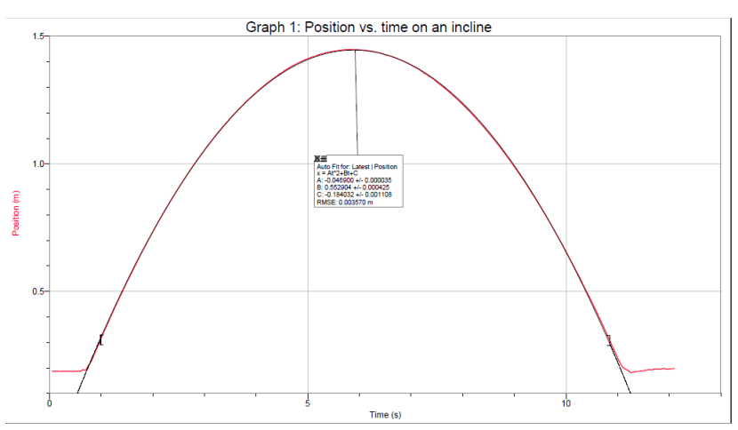
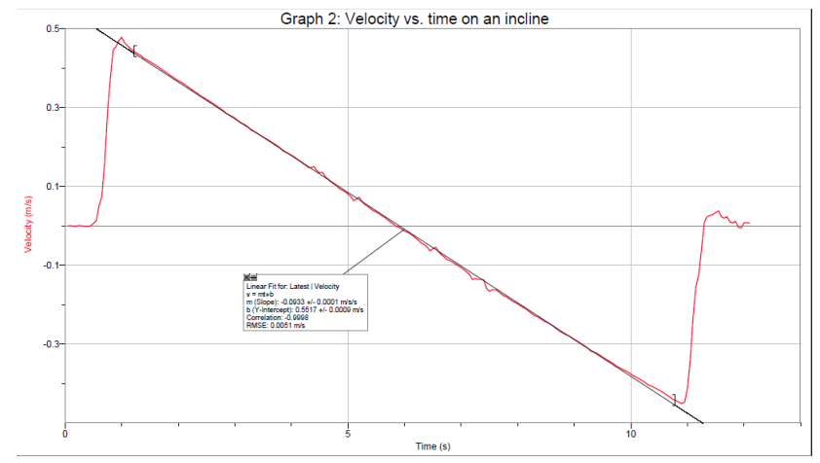
Preliminary
Tilt track and launch glider up incline 1 m.
2 graphs:
Position vs time (curve fit, 𝐴𝑥²+𝐵𝑥+𝐶)
Velocity vs time (linear fit)

Slide 4
PART 1 – Determining g on an incline
d = 1 m
Let the glider fall down the incline.
From the v vs t graph, use linear fit to get acceleration
Important equation: $a=g\frac{h}{d}$
Graph 3: a vs h → slope = g_{exp1}

Slide 5
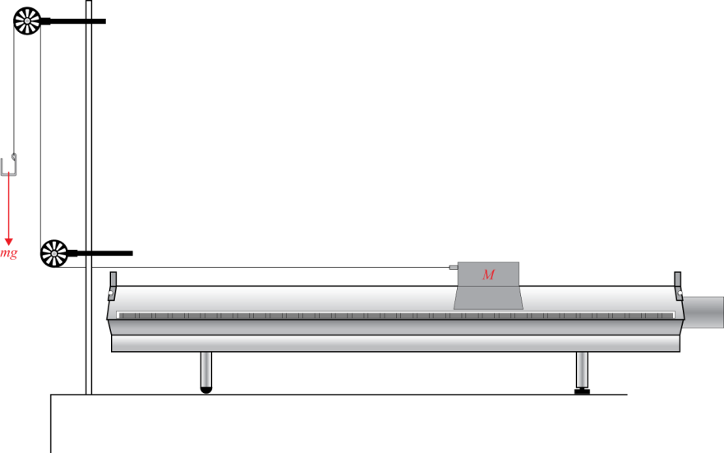
PART 2 – Investigating Newton’s second law
Use mass on string to pull glider
Get acceleration from v vs t graph (same as before)
Important equation: $a=g\frac{m}{(M+m)}$
Graph 4: a vs $\frac{m}{(M+m)}$ → slope = g_{exp2}

Slide 6
The setup
Air supply
Air track

Slide 7
The setup
Motion detector
Glider

Slide 8
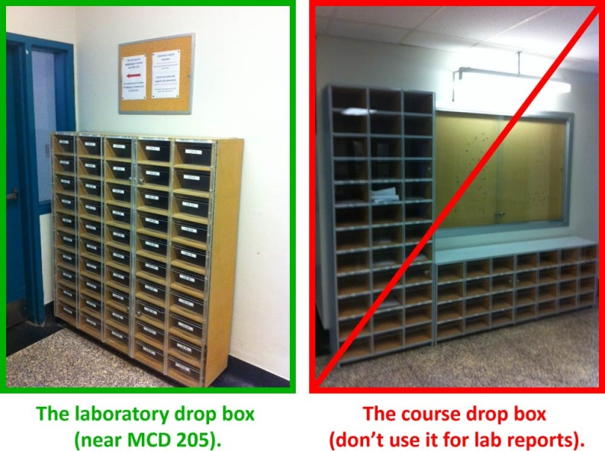
CLEAN UP
DUE DATE
The report is due in 1 week before 5pm in the lab drop box.
Turn off the air supply, computer, and don’t forget to take your USB key.
Put the spacers and the masses back in the tupperware container. You may leave the mass hanger attached to the string for students in the next session.
Please recycle scrap paper and throw away any garbage. Please leave your station as clean as you can.
Push back the monitor, keyboard, and mouse. Please push your chair back under the table.
Thank you!
PRE-LAB
Don’t forget to do your pre-lab for the next experiment!
Notes:
Comments for TAs: leave this slide on the TV monitors when you are not using them for teaching.

