Slide 1
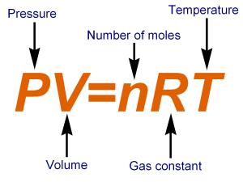
Ideal Gas Law
1st year physics laboratories
University of Ottawa
https://uottawa.brightspace.com/d2l/home

Slide 2
INTRODUCTION
In this experiment you will investigate the relationship between pressure and several variables (temperature, volume, number of gas molecules) that affect pressure in a closed system.
The key equation to be used is Boltzmann’s equation of state: $PV=nRT$
You will also find the following information useful:
One mole of gas $\left(n=1 mol\right)$ occupies the same volume $\left(V=22.4 L\right)$ at standard pressure $\left(P=1.013×10^{5} Pa\right)$ and standard temperature $\left(T_{0}=273.15 K=0 °C\right)$.
where $P$ is pressure, $V$ is volume, $n$ is number of moles, $R$ is the universal gas constant, and $T$ is the temperature

Slide 3
OBJECTIVES
Collect data for a sample of air in a closed system: 1) pressure vs. volume 2) pressure vs. number of moles 3) pressure vs. temperature
Determine the relationships between these variables and then formulate a single expression relating these variables.
Determine whether air behaves as an ideal gas.
Determine the absolute zero temperature.

Slide 4
SAFETY WARNING!!
You will be working with near boiling water in this experiment.
Please wear protective gloves when handling any high temperature surfaces.
Please turn off the hot plate when it is not in use.
If the water begins to boil before your collection time is up, turn off the hot plate.

Slide 5
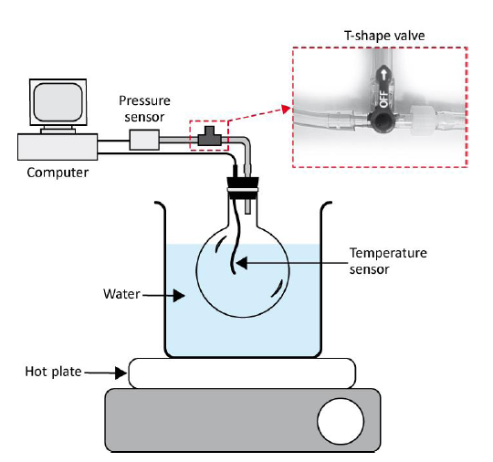
$P$ vs. $T$
Fill the beaker to the 350 mL mark.
Your initial values should be around: $T≈22 °C$, $P≈100 kPa$.
Reduce the pressure to between 50 and 60 kPa before you start. PHOTOS AND VIDEO ON NEXT TWO SLIDES.

Slide 6
The setup for $P$ vs. $T$
Pressure sensor
Gloves
Hot plate and glass bulb assembly
Syringes
Sonde de température
Temperature
probe

Slide 7
Decreasing the initial pressure

Slide 8
$P$ vs. $T$ (cont.)
Set data collection to 600 s.
Turn the hot plate to maximum and wait until the temperature has increased by 5 °C before pressing collect.
Make sure to stop data collection if your water begins to boil before the 600 s is finished.
Prepare your graph of pressure vs. temperature.

Slide 9
$P$ vs. $V$
Attach the 20 mL syringe directly to the pressure sensor.
Use “Events with Entry” mode for data collection and make sure you use a 10 s average.
Record the pressure at each step as you change the volume from 10 to 20 mL by steps of 2 mL. Repeat for 20 to 10 mL.
Prepare your graph of pressure vs. inverse volume.

Slide 10
The setup for $P$ vs. 1/$V$ and $P$ vs. $n$

Slide 11
$P$ vs. $n$
This part uses the same setup as part 2 (pressure and volume).
NB: 1 puff = 3 mL
Disconnect the syringe and position the piston so V = 1 puff. Reconnect the syringe and adjust the volume to 10 mL. Record the pressure.
Increase the number of puffs by 1 and repeat the measure-ment until you hit a total of 6 puffs. Remember you are adjusting the pressure to a constant 10 mL each time you re-connect the syringe.
Prepare your graph of pressure vs. # puffs.

Slide 12
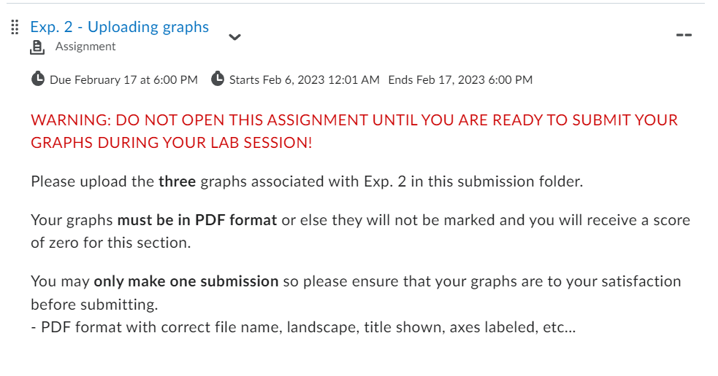
GRAPHS
There are three graphs to create and submit for this lab. Use the “Uploading graphs” tool at the bottom of the experiment page in Brightspace.

Slide 13
CLEAN UP
DUE DATE
Turn off the computer and don’t forget to take your USB key.
Make sure the hot plate is turned off and unplugged.
Leave the water in the beaker for the next students.
Re-connect the pressure sensor to the flask assembly like it was at the beginning of the lab session.
Please recycle scrap paper and throw away any garbage. Please leave your station as clean as you can.
Push back the monitor, keyboard, and mouse. Please push your chair back under the table.
Thank you!
The report is due at the end of the lab session, i.e., at 12:50pm or 5:20pm.
Don’t forget to do your pre-lab for the next experiment!
PRE-LAB
Notes:
Comments for TAs: leave this slide on the TV monitors when you are not using them for teaching.

