Slide 1
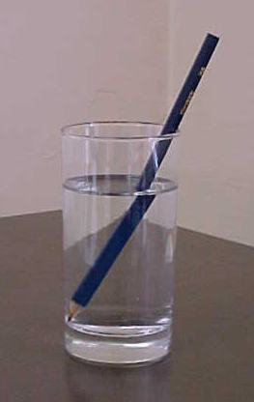
Geometrical Optics
1st year physics laboratories
University of Ottawa
https://uottawa.brightspace.com/d2l/home

Slide 2
INTRODUCTION
Geometrical optics deals with light as a ray that can be bounced (reflected) or bent (refracted) by different mechanisms.
Refraction is the bending of light when it goes from one medium to another if the two media have different refractive indices.
Dispersion (index of refraction depends on wavelength) is demonstrated by the spatial separation of light into the different colours that it is composed of.
Lenses can be used to focus (converge) or defocus (diverge) light rays.
Simple optical devices, such as a microscope, can be fabricated using optical components as simple as a pair of lenses.

Slide 3
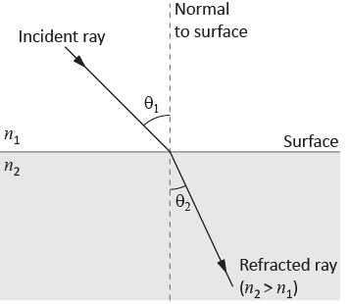
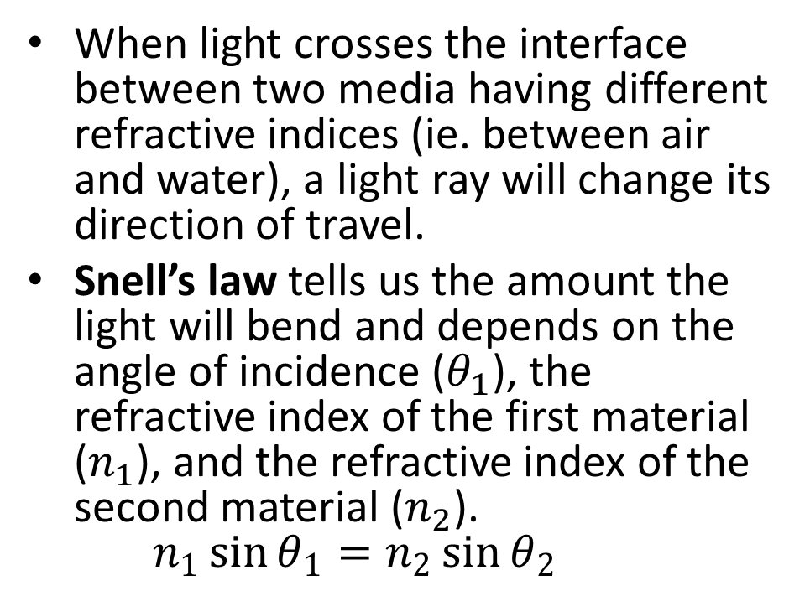
REFRACTION
When light crosses the interface between two media having different refractive indices (ie. between air and water), a light ray will change its direction of travel.
Snell’s law tells us the amount the light will bend and depends on the angle of incidence ($θ_{1}$), the refractive index of the first material ($n_{1}$), and the refractive index of the second material ($n_{2}$).
$n_{1}\sin{θ_{1}}=n_{2}\sin{θ_{2}}$

Slide 4
DISPERSION
The index of refraction for light varies with the wavelength (colour) of the light. The index is lower for longer wavelengths and higher for shorter wavelengths.
White light is made up of a spectrum of different colours and when it enters a material at an angle, each colour will spatially separate because it will bend by a slightly different amount.
When we send white light through a prism, the double bending in the same direction will cause enough spatial separation of colours so that you’ll see a rainbow pattern.

Slide 5
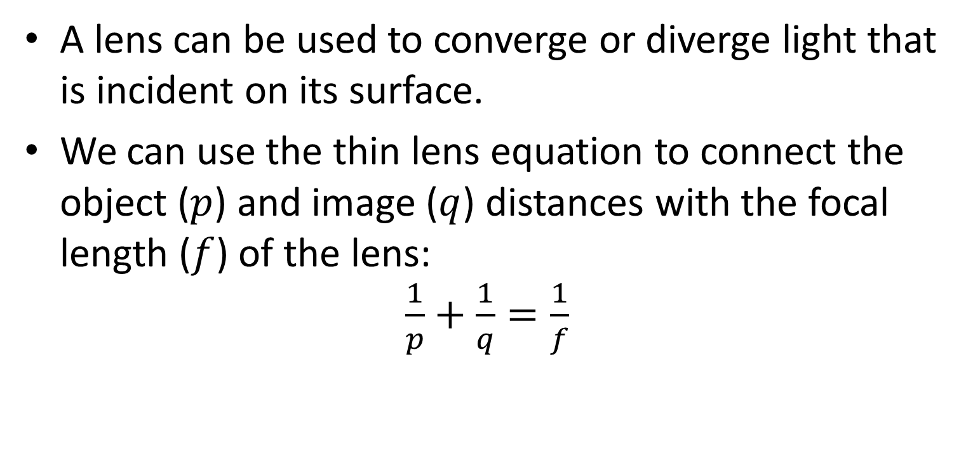
LENSES
A lens can be used to converge or diverge light that is incident on its surface.
We can use the thin lens equation to connect the object ($p$) and image ($q$) distances with the focal length ($f$) of the lens:
$\frac{1}{p}+\frac{1}{q}=\frac{1}{f}$

Slide 6
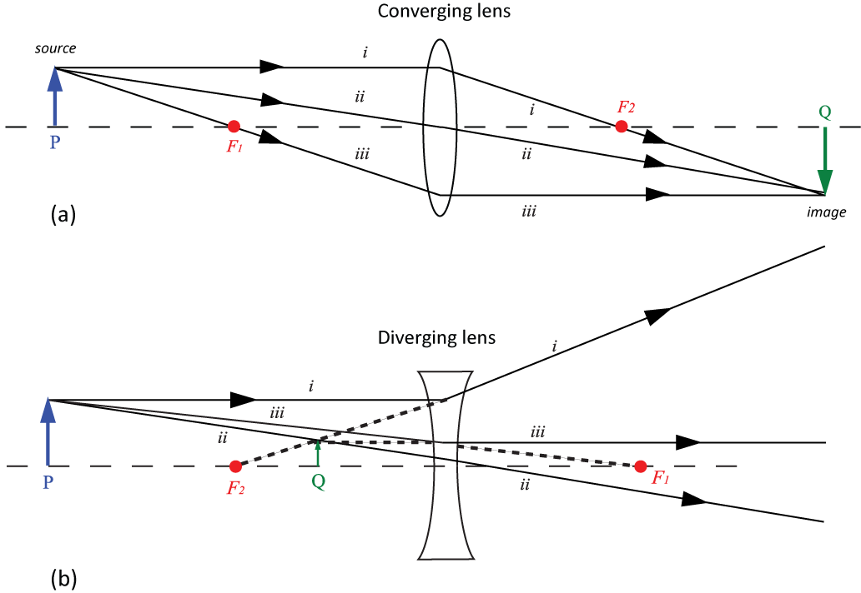
RAY DIAGRAMS
We can construct ray diagrams using three simple rules.
F₁ and F₂ are the focal points.

Slide 7
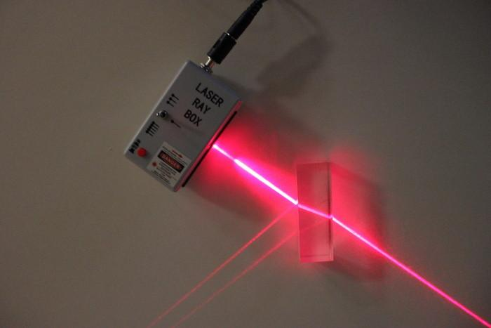
REFRACTION
Use a single beam from the laser ray box to demon-strate reflection and refraction of light.

Slide 8
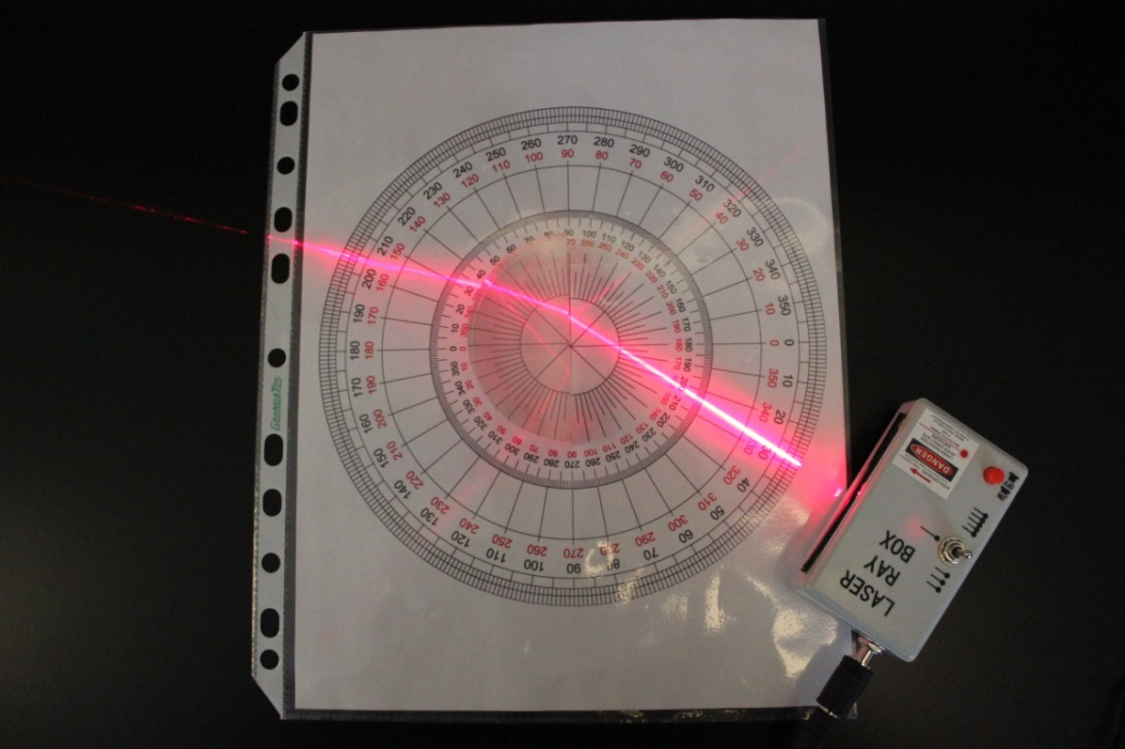
REFRACTION OF LIGHT
You will use Snell’s law the experimentally determine the index of refraction of a piece of acrylic.
Method 1 by calculation
(see previous slide).
Method 2 by making a
graph of incident angle
vs. refracted angle
(setup shown to the
right).

Slide 9
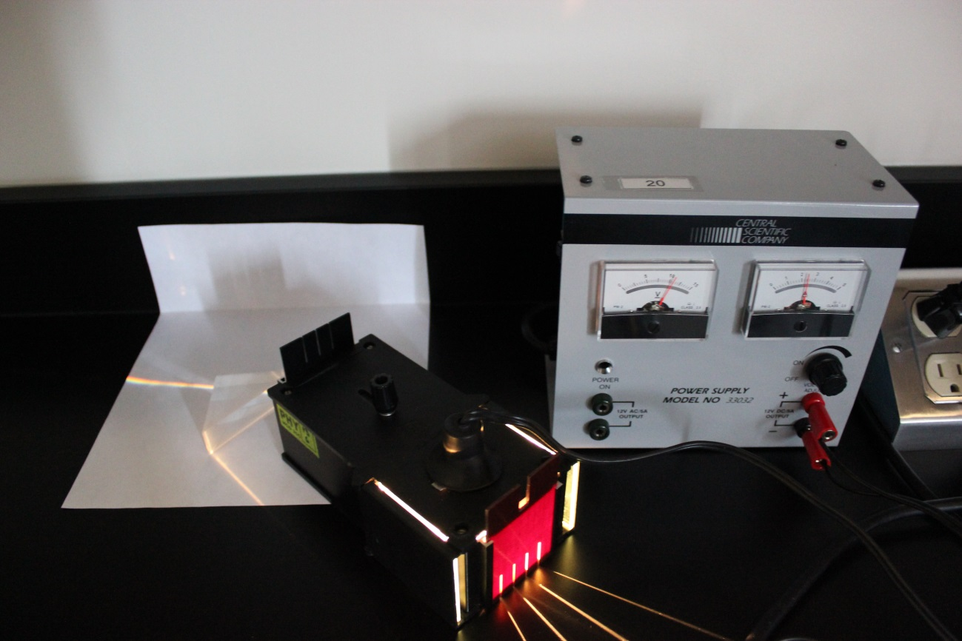
DISPERSION SETUP
Investigate the dispersion of white light as you shoot it through a prism.
Which colour has the largest refraction angle?

Slide 10
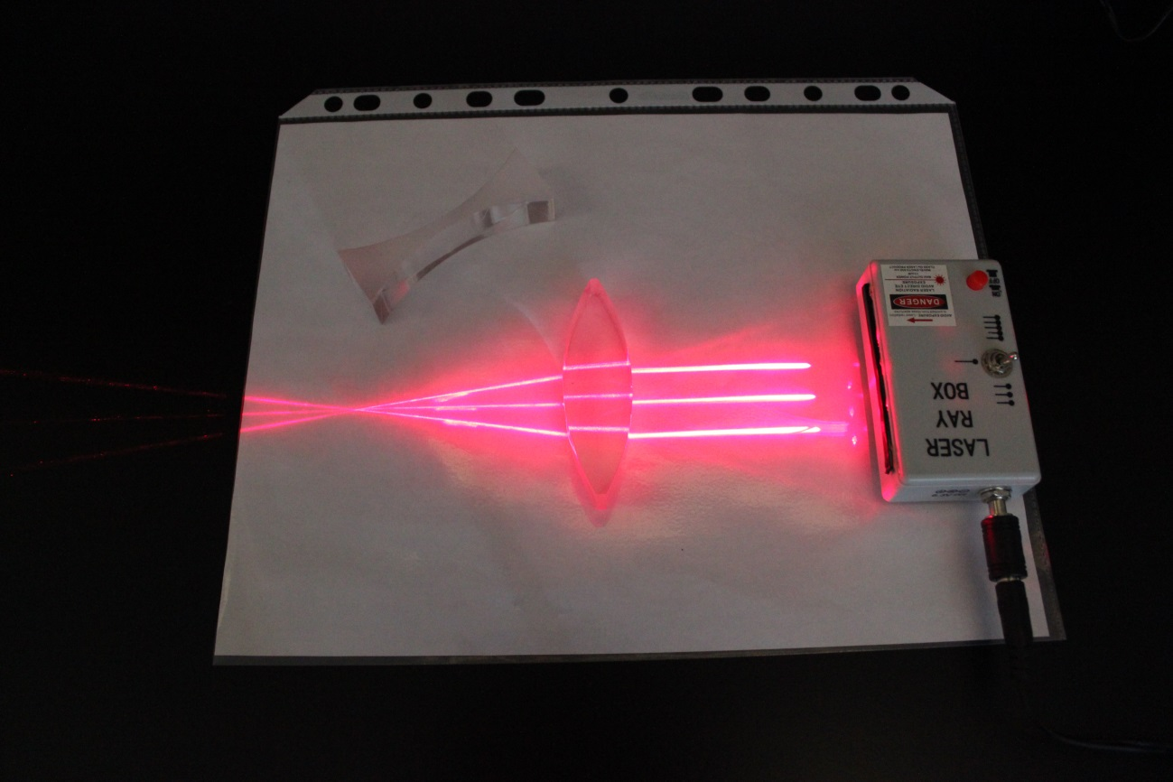
FOCUSING LENS SETUP
You can directly measure the focal length of the double concave and double convex acrylic lenses using three beams from the laser ray box.

Slide 11
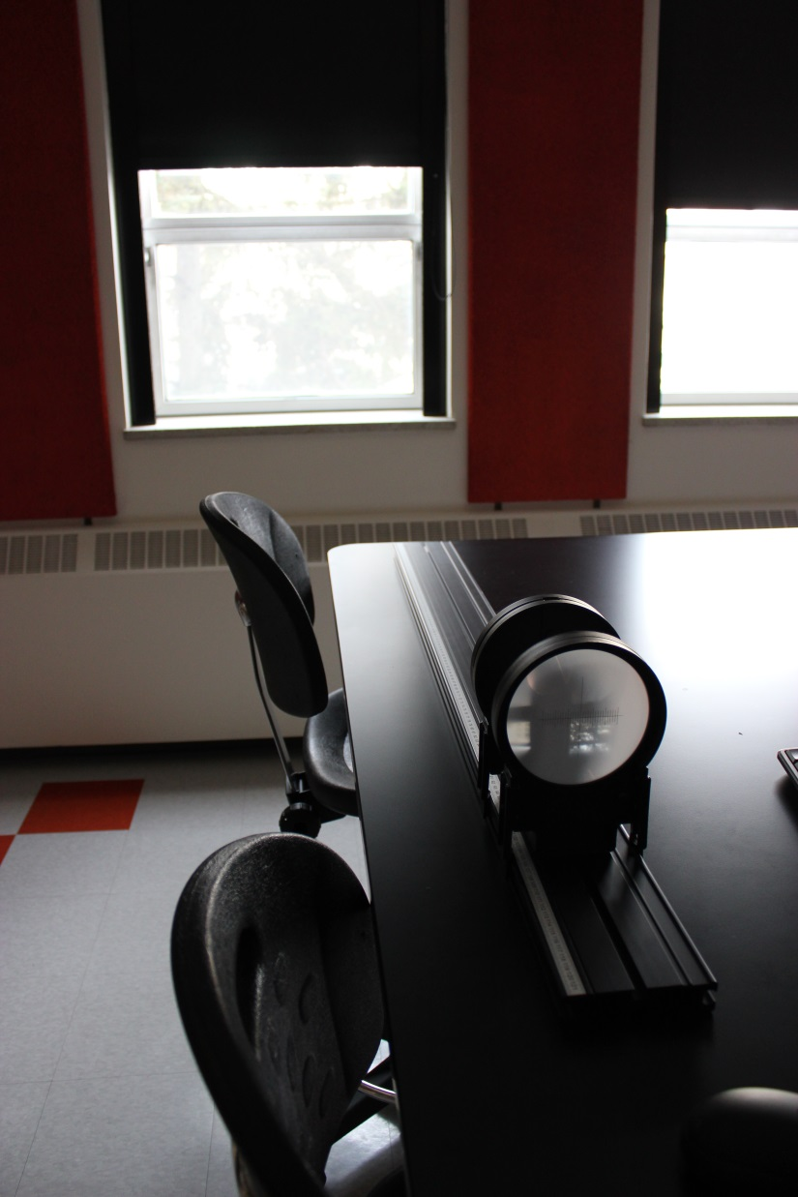
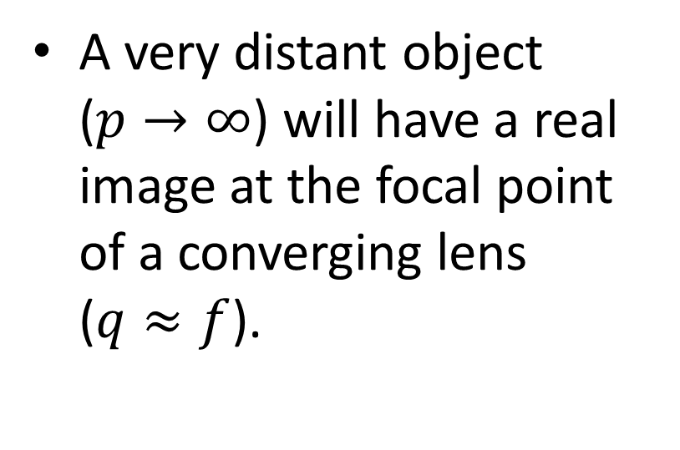
FOCUSING AN
OBJECT AT INFINITY
window
A very distant object
($p→∞$) will have a real image at the focal point of a converging lens
($q≈f$).
lens
screen

Slide 12
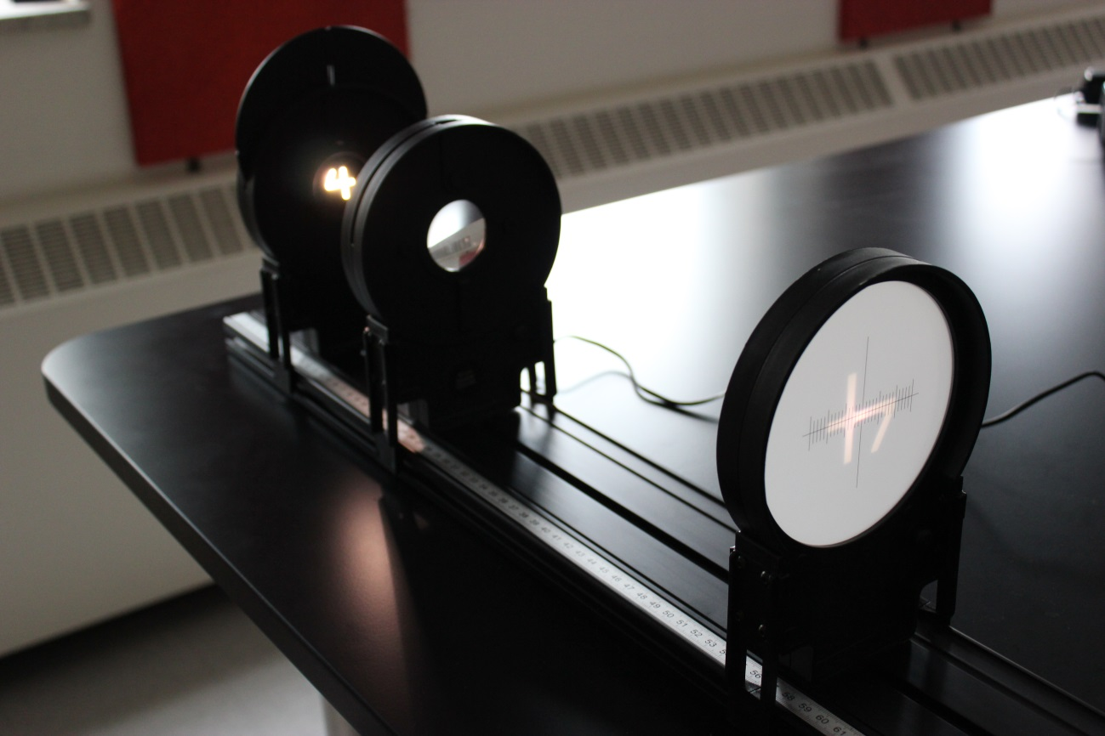
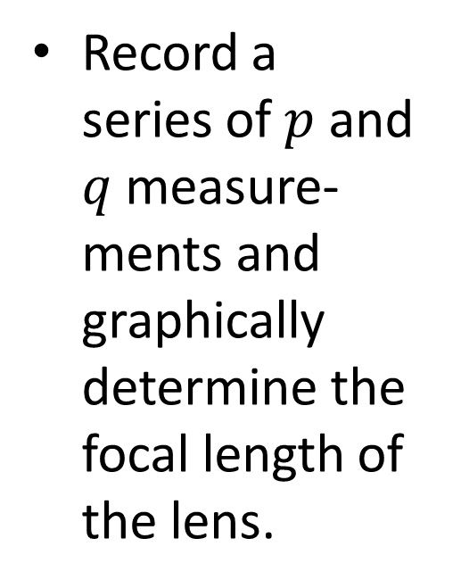
OBJECT CLOSER THAN INFINITY
Record a series of $p$ and $q$ measure-ments and graphically determine the focal length of the lens.
light
source
lens (10 cm
convex)
screen

Slide 13
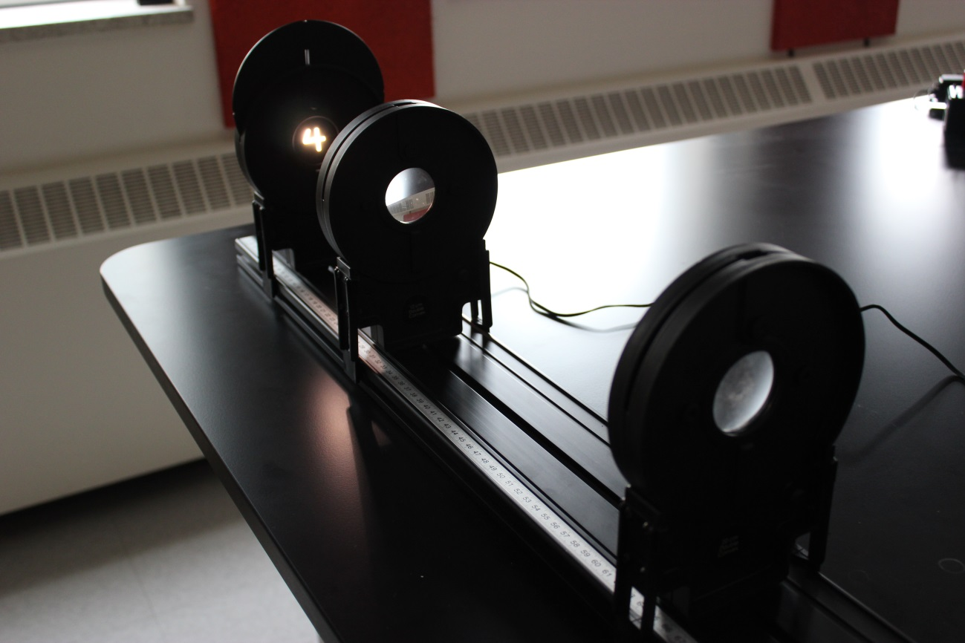
MICROSCOPE SETUP
Use two lenses to assemble a microscope to magnify an image.
Determine the magnification, M.
light
source
lens (10 cm
convex)
lens (20 cm
convex)

Slide 14
CLEAN UP
DUE DATE
Turn off the computer and don’t forget to take your USB key.
Make sure the laser ray box is turned off. Put back the 4 acrylic pieces and the 360° protractor.
Make sure the white light source is turned off. Put the light source, the two lenses, and the screen back on the optical track.
Please recycle scrap paper and throw away any garbage. Please leave your station as clean as you can.
Push back the monitor, keyboard, and mouse. Please push your chair back under the table.
Thank you!
The report is due at the end of the lab session.
Don’t forget to do your pre-lab for the next experiment!
PRE-LAB
Notes:
Comments for TAs: leave this slide on the TV monitors when you are not using them for teaching.

