Slide 1
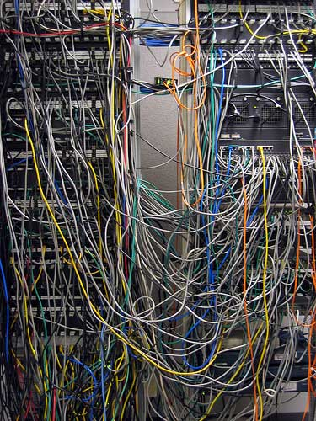
Electric Circuits
(3h)
1st year physics laboratories
University of Ottawa
https://uottawa.brightspace.com/d2l/home

Slide 2
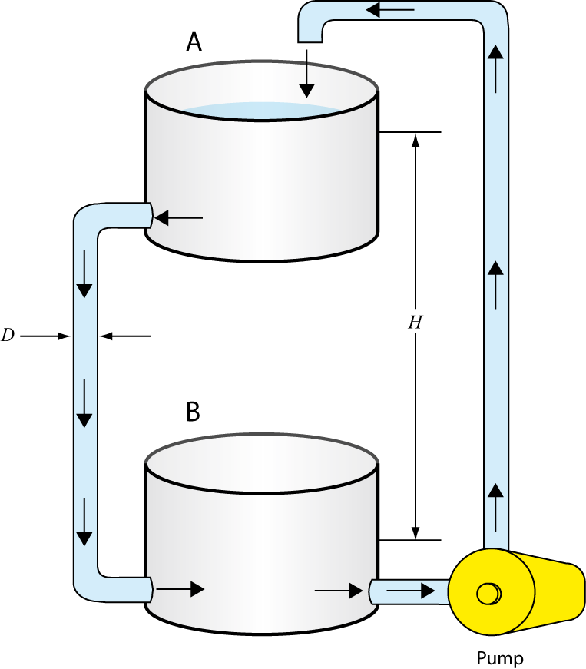
INTRODUCTION
An electrical circuit consists of a closed loop with a number of different elements through which electric current passes.
Important variables are voltage (V), current (I), resistance (R), and conductance (C).
Consider the water pump analogy to understand voltage.
Notes:
TA’s should explain the water pump analogy:
Water pump gives potential energy to water, same as how battery gives energy to electrical charges.
The height difference defines the magnitude of water’s potential energy, similar to how the voltage between the negative and positive terminals of the battery.
The amount of droplets passing a given point is like the current, measured in A (the number of electrons that pass a given point in a circuit in one second).
The diameter of the water pipe is like the conductance, C, in a circuit. The inverse of conductance is resistance (measured in Ω).

Slide 3
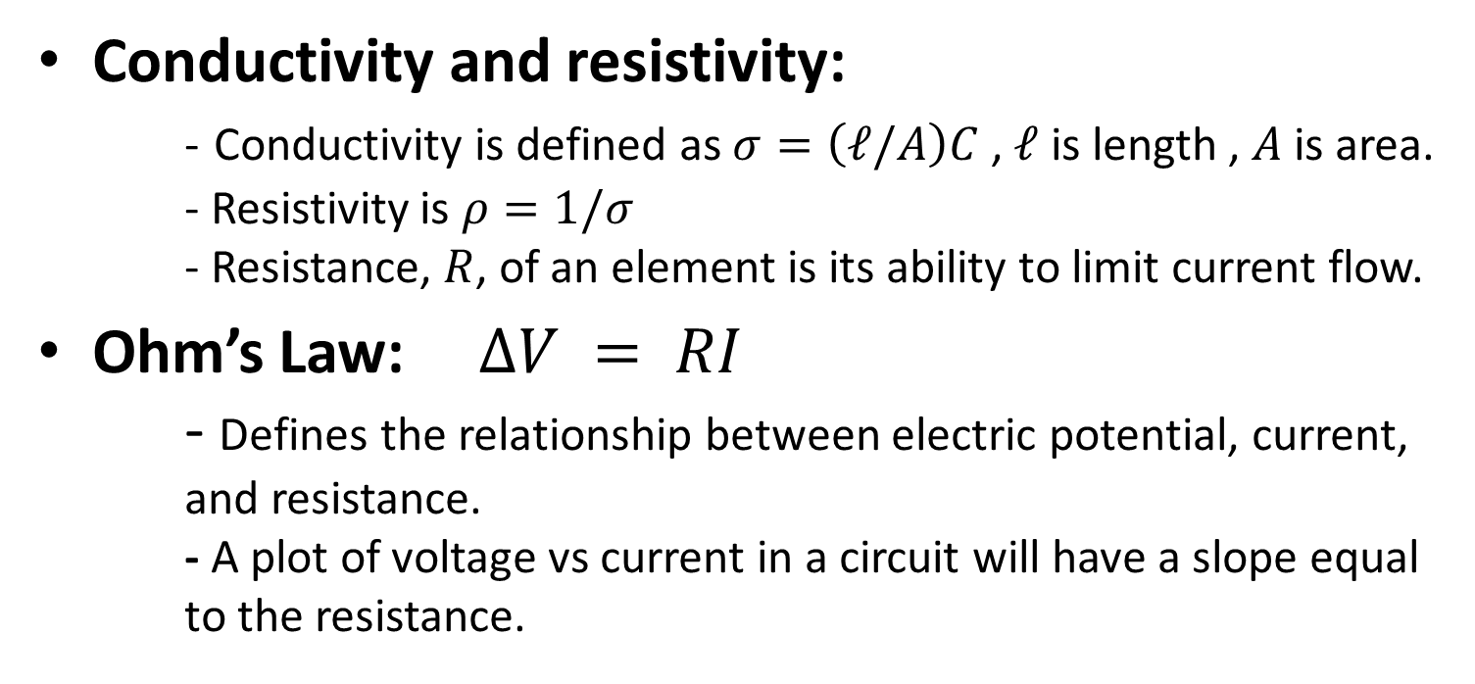
CURRENT, VOLTAGE, and OHM’S LAW
Conductivity and resistivity:
- Conductivity is defined as $σ=\left(ℓ/A\right)C$ , $ℓ$ is length , $A$ is area.
- Resistivity is $ρ=1/σ$
- Resistance, $R$, of an element is its ability to limit current flow.
Ohm’s Law: $∆V = RI$
- Defines the relationship between electric potential, current, and resistance.
- A plot of voltage vs current in a circuit will have a slope equal to the resistance.

Slide 4
KIRCHOFF’s RULES
The Junction Rule (conservation of charge)
  The sum of the currents entering any junction must equal the sum of the currents leaving that junction.
The Loop Rule (conservation of energy)
  The sum of the voltage changes across each element around any closed circuit loop must be zero.
Consider the circuit on the following slide…

Slide 5
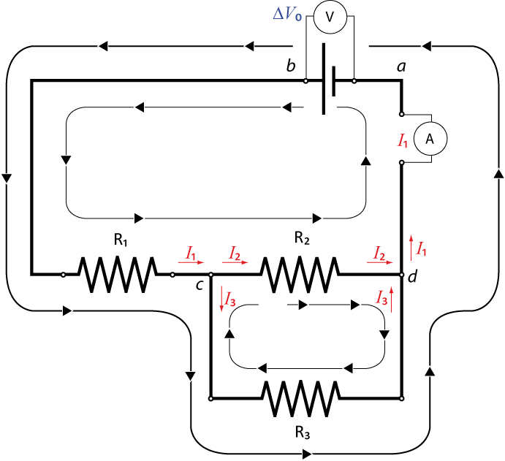
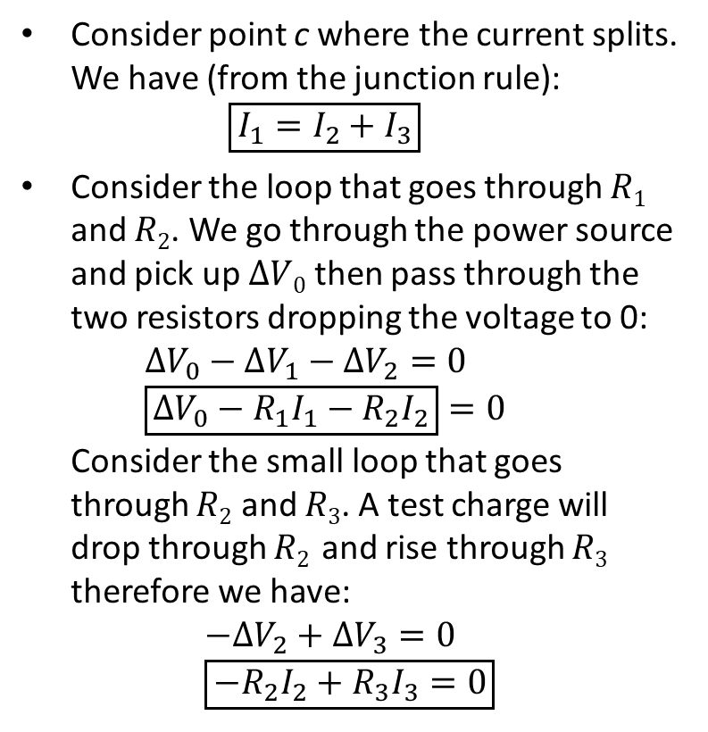
SAMPLE CIRCUIT
Consider point c where the current splits. We have (from the junction rule):
$\boxed{I_{1}=I_{2}+I_{3}}$
Consider the loop that goes through $R1$ and $R2$. We go through the power source and pick up $ΔV0$ then pass through the two resistors dropping the voltage to 0:
$ΔV_{0}−ΔV_{1}−ΔV_{2}=0$
$\boxed{ΔV_{0}−R_{1}I_{1}−R_{2}I_{2}}=0$
Consider the small loop that goes through $R2$ and $R3$. A test charge will drop through $R2$ and rise through $R3$ therefore we have:
$$−ΔV_{2}+ΔV_{3}=0 \\ \boxed{−R_{2}I_{2}+R_{3}I_{3}=0}$$

Slide 6
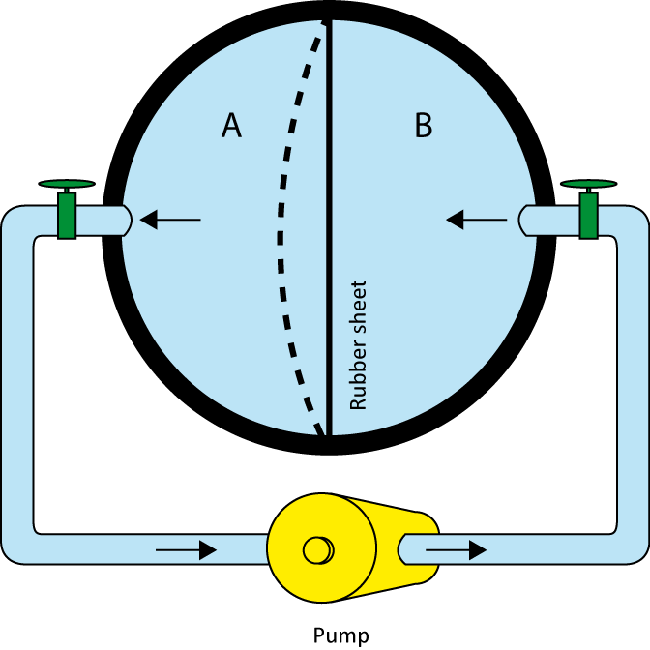
CAPACITORS IN CIRCUITS
A capacitor is used to store electrical energy in a circuit.
A simple analogy can be seen in the figure of the hollow sphere divided into two equal volumes.
  Water is moved from volume A to B and elastic energy is stored in the rubber sheet due to the work done on the water.
  The energy in the rubber is analogous to the stored electric potential energy in a capacitor.

Slide 7
OBJECTIVES
Measuring a resistance value using colour code and Ohmmeter
Verify Ohm’s law using a simple circuit on a breadboard
Investigate simple circuits with resistors in series and parallel.
Review Kirchoff’s rules for circuit analysis.
Investigate simple circuits with combinations of capacitors.

Slide 8
TUTORIALS!
You should have read the following tutorials before coming to the lab session:
  Building circuits
  Using a multimeter
The tutorials contain vital information on how to manipulate the electronics you will be using in the lab today to investigate simple circuits!

Slide 9
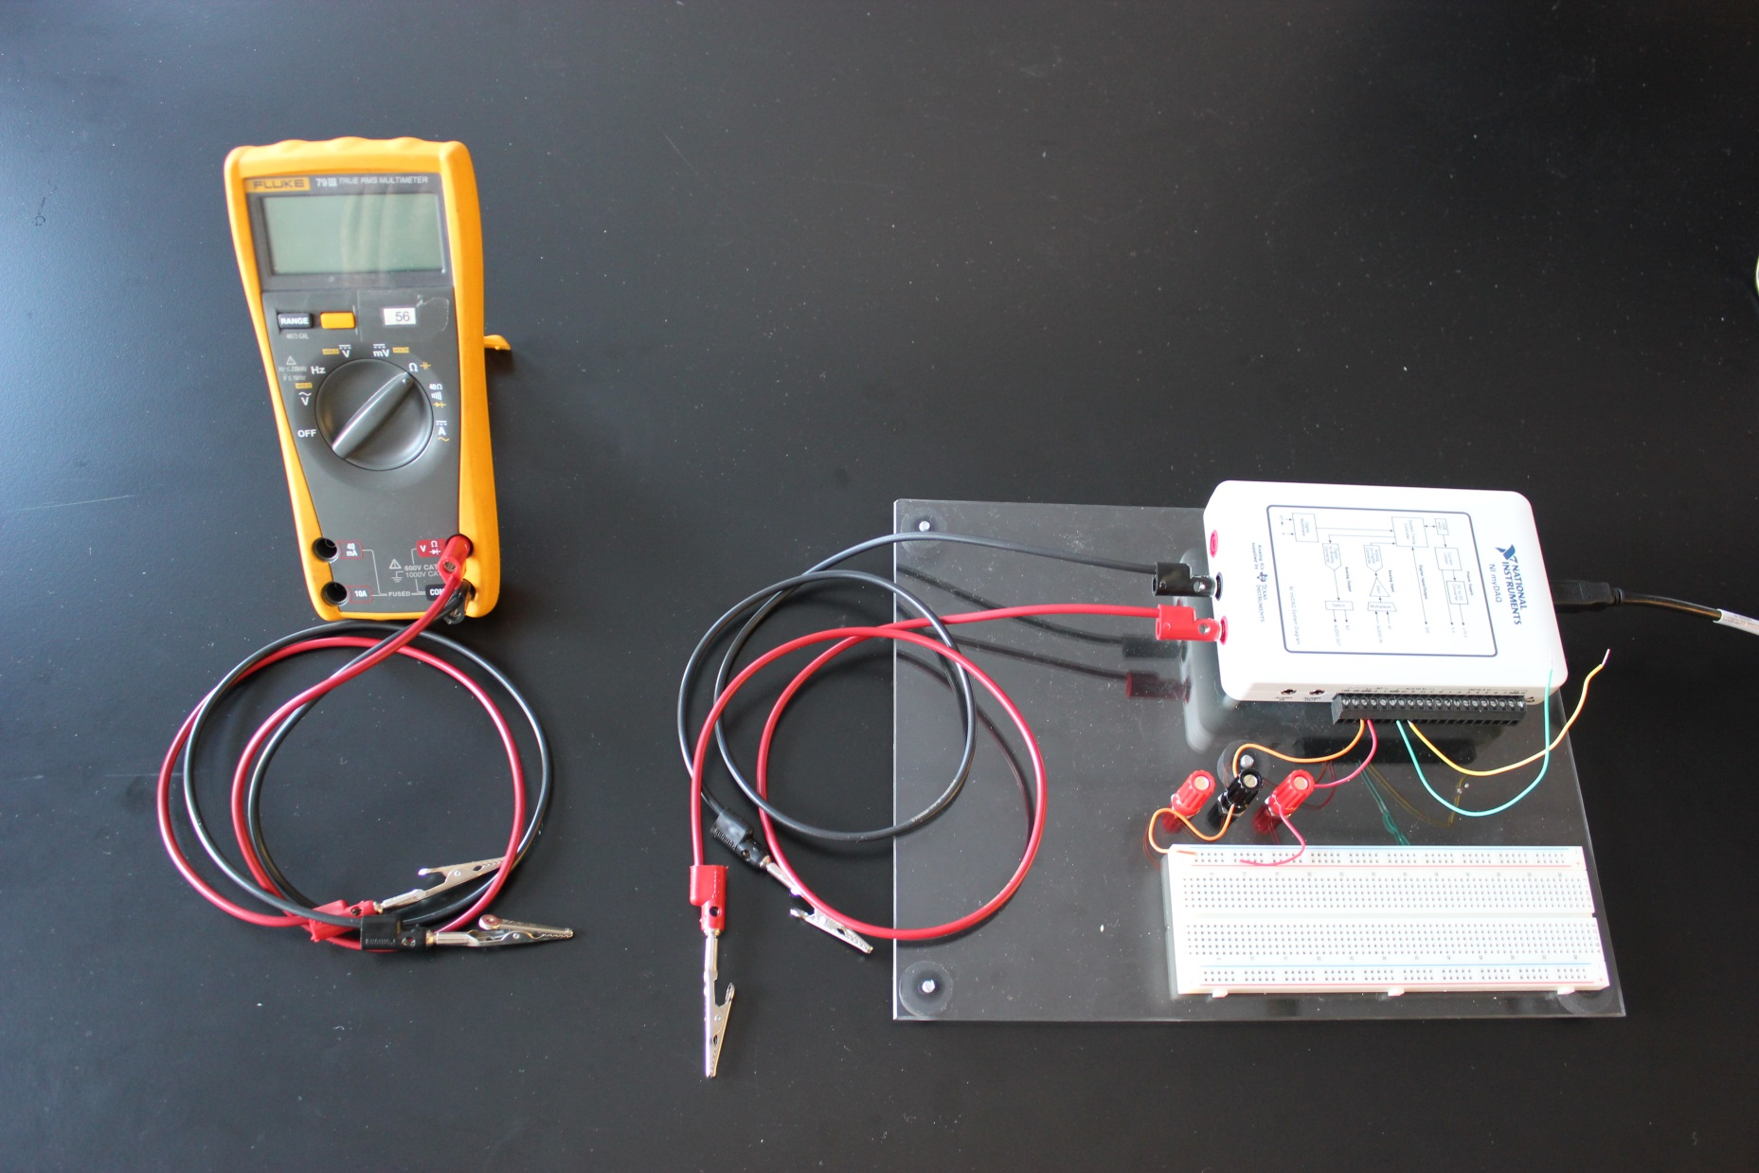
EQUIPMENT
Fluke
multimeter
myDAQ:
Multimeter
Power supply
Breadboard

Slide 10
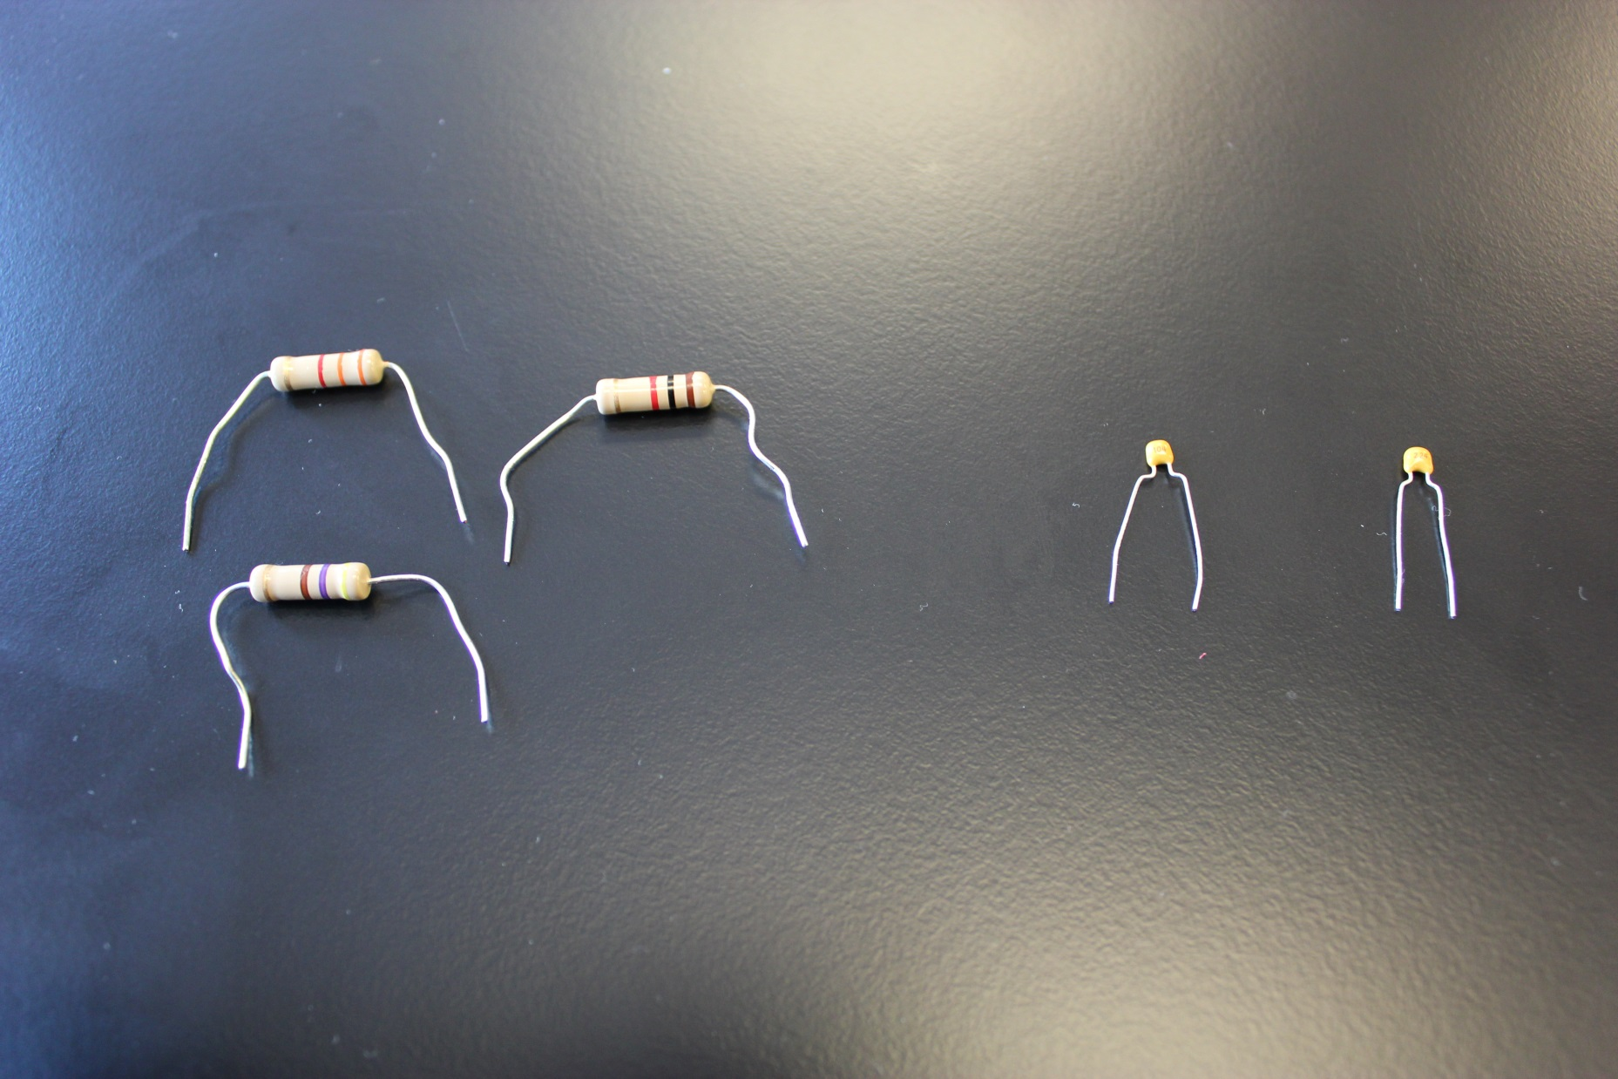
RESISTORS AND CAPACITORS
The resistors have a colour code on them that gives their rated resistance and uncertainty.
The capacitors use a 3 digit code – the first two numbers are the value and third number is the multiplier times pF: 543 means 54 x 1000 pF = 54nF.

Slide 11
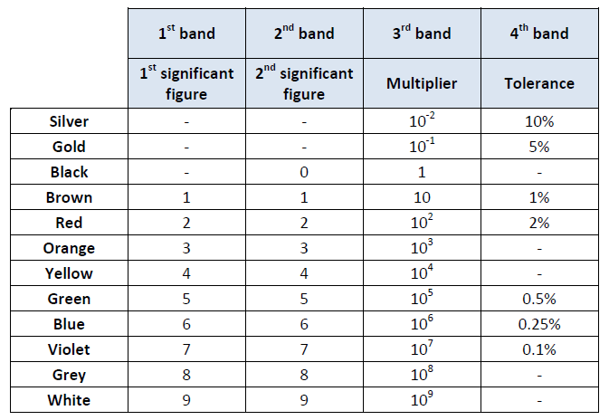
RESISTOR COLOUR CHART
Example:
1- Red (2)
2- Black (0)
3- Orange (10³)
4- Gold (5%)
Resistance value:
20 × 10³ Ω ± 5%
(20 ± 1) kΩ
You will use this chart to complete PART 1.

Slide 12
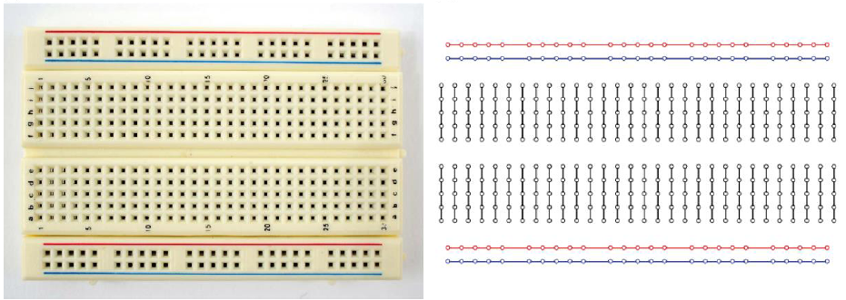
USING THE BREADBOARD
On the left is a sample of the type of breadboard you will be using.
On the right is the hidden connection pattern of the pins in the board.

Slide 13
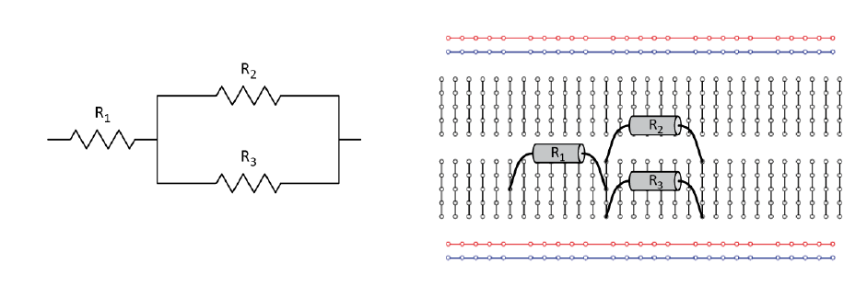
BUILDING A CIRCUIT FROM A DIAGRAM
On the left is the circuit diagram of a combination of resistors in series and parallel.
On the right is an example of how you can connect the resistors using the hidden connection pattern.

Slide 14
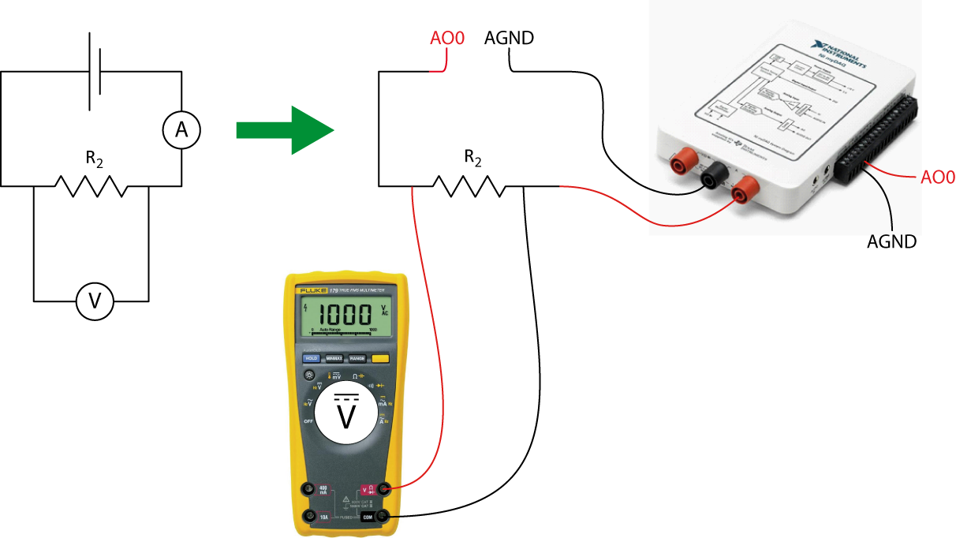
SETTING UP VOLTMETER AND AMMETER
Your voltmeter (Fluke) will be in parallel with the resistor.
Your ammeter (myDAQ) will be in series with the resistor.
You will build this circuit in PART 2 to verify Ohm’s law.

Slide 15
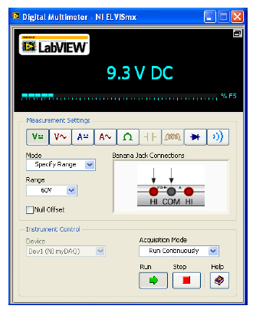
myDAQ DIGITAL MULTIMETER
The digital multimeter program is located in the NIElvis folder on your desktop.
You can use the software to measure voltage, current and resistance.
The range can be specified or leave it on auto mode so that the software will determine your range for you.
Depending on what variable you are measuring, you might need to change the position of the banana cable.

Slide 16
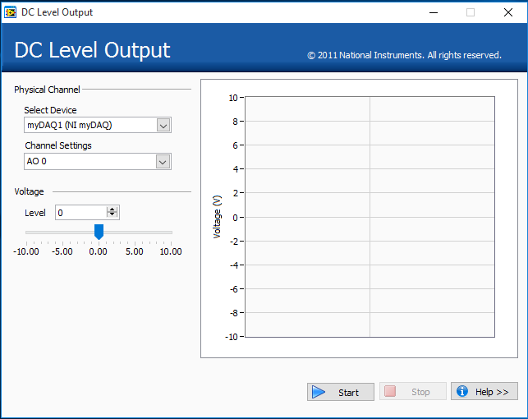
DC LEVEL POWER SUPPLY PROGRAM
The DC Level Power Supply program is located in the NIElvis folder on your desktop.
The correct channels for output (myDAQ AO 0) should be selected then click the “Start” button.
You can change the voltage output in as necessary (range is 0 – 5 V) (“hit Enter”).
The voltage output is shown on the graph.

Slide 17
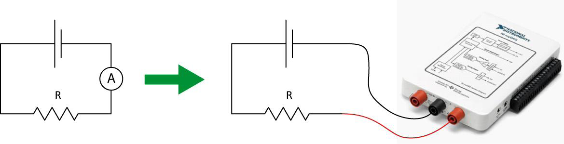
UNCERTAINTIES ON METER READINGS
Example: You want to use your myDAQ to read the current in a circuit.
- Your ammeter has a reading of 0.057 A (set on the 1.000 A range).
- From the specs. of your myDAQ, the accuracy is ± (0.5% + 2 mA).
- The % is the percentage of your value and the 2 mA is the constant you add to the percentage.
- → ± (0.5% + 2 mA) = ± (0.005 × 0.057 + 0.002) A = ± 0.002285 A
- Therefore your final reading is I = (0.057 ± 0.002) A

Slide 18
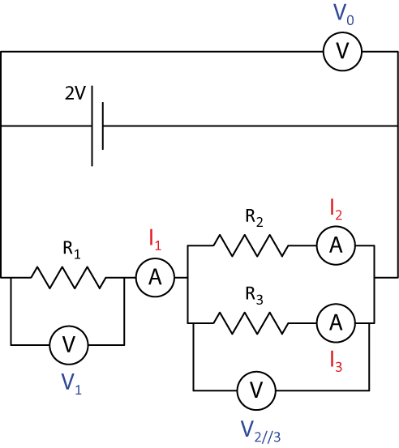
A CIRCUIT WITH SEVERAL RESISTORS
In PART 3 you will measure the effective resistance of various combinations of resistors in series and parallel.
In PART 4 you will verify Kirchoff’s rules using the circuit shown on the right along with your voltmeter (FLUKE) and ammeter (myDAQ) to measure the voltage and current at different sections.

Slide 19
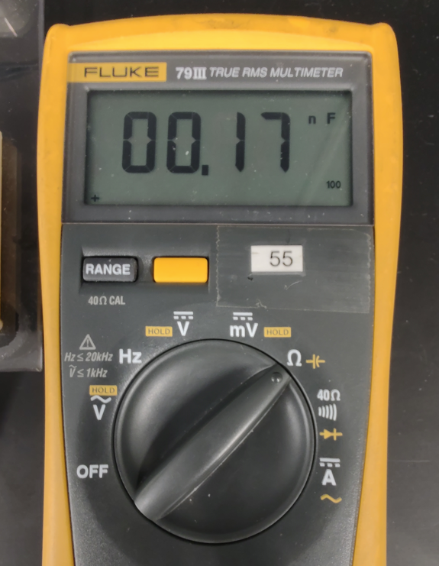
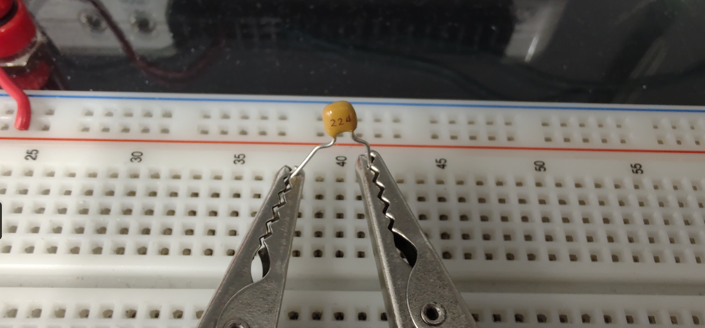
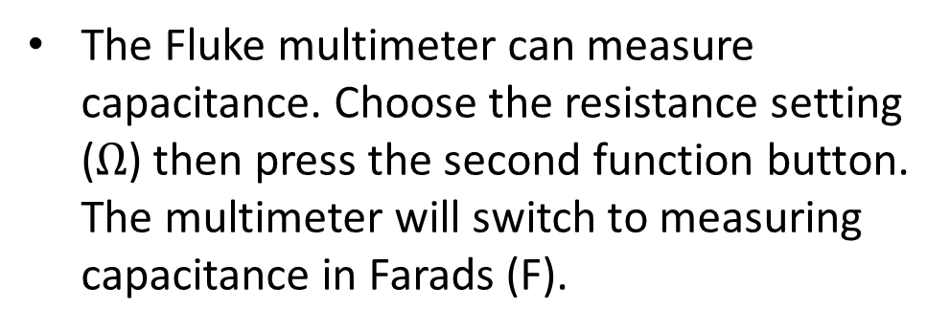
MEASURING CAPACITANCE (PART 5)
The Fluke multimeter can measure capacitance. Choose the resistance setting ($Ω$) then press the second function button. The multimeter will switch to measuring capacitance in Farads (F).

Slide 20
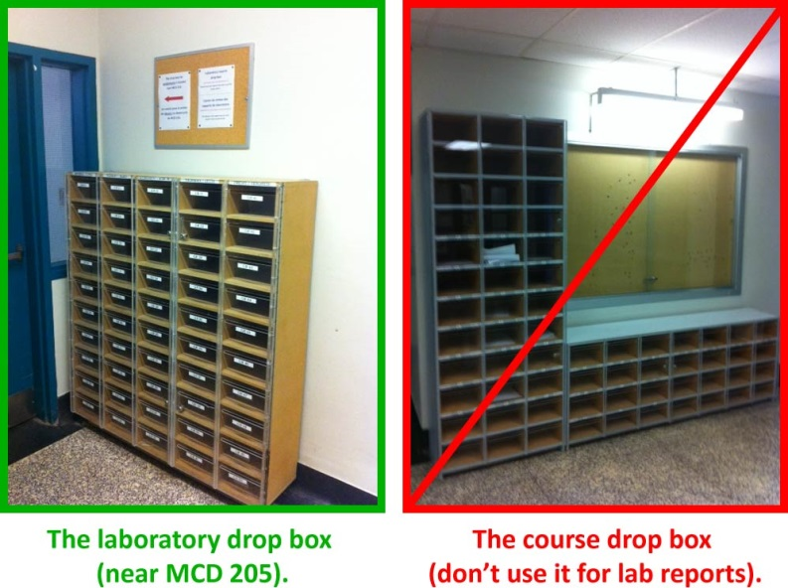
CLEAN UP
DUE DATE
Turn off the computer and don’t forget to take your USB key.
Turn off the Fluke multimeter. Disassemble your circuit and put back the three resistors and the two capacitors in your wire kit box.
Please recycle scrap paper and throw away any garbage. Please leave your station as clean as you can.
Push back the monitor, keyboard, and mouse. Please push your chair back under the table.
Thank you!
The report is due in 1 week before 5pm.
PRE-LAB
Don’t forget to do your pre-lab
for the next experiment!
Notes:
Comments for TAs: leave this slide on the TV monitors when you are not using them for teaching.
This slide should be used if you are teaching 1122/1322 or 1522/1722.

Slide 21

CLEAN UP
DUE DATE
The report is due at the end of the lab session.
Please give it to your TA.
Turn off the computer and don’t forget to take your USB key.
Turn off the Fluke multimeter. Disassemble your circuit and put back the three resistors and the two capacitors in your wire kit box.
Please recycle scrap paper and throw away any garbage. Please leave your station as clean as you can.
Push back the monitor, keyboard, and mouse. Please push your chair back under the table.
Thank you!
You are about to complete your last physics lab for this semester!
Notes:
Comments for TAs: leave this slide on the TV monitors when you are not using them for teaching.
This slide should only be used if this you are teaching 1124 or 1524.

