Slide 1
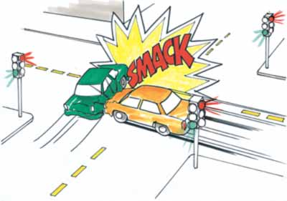
Exp. 4: Conservation of Momentum
1st year physics laboratories
University of Ottawa
https://uottawa.blackboard.com/

Slide 2
INTRODUCTION
In this experiment you will study the conservation of linear momentum and energy in two different types of collisions in 1D.
A moving object possesses kinetic energy (E = mv²/2) and momentum (p = mv).
When two objects undergo a collision, the velocity (and thus momentum) of each object will change.
We will examine 2 types of collisions: elastic and inelastic.

Slide 3
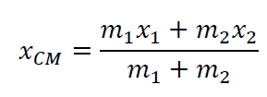
INTRODUCTION (cont.)
We consider two gliders on an air track to be our single, closed system.
The position of the centre of mass for the two gliders, x_{CM} is: where the indices 1 and 2 refer to 1st and 2nd object.
In part 1 you will analyze the motion of two gliders during a collision and examine the behaviour of their centre of mass.

Slide 4
INTRODUCTION (cont.)
In a closed system, any force that one object exerts on another are internal to the system.
In parts 2 and 3, we will examine the momentum and kinetic energy of both gliders undergoing elastic and inelastic collision to see how these forces affect the property of our system.
When two objects collide, the total momentum is conserved:

Slide 5
OBJECTIVES
Compare position-time graphs for individual gliders with one for the centre of mass of the system.
Compare velocity-time graphs for gliders undergoing two types of collisions.
Compare momentum and kinetic energy of your system before and after the collisions.

Slide 6
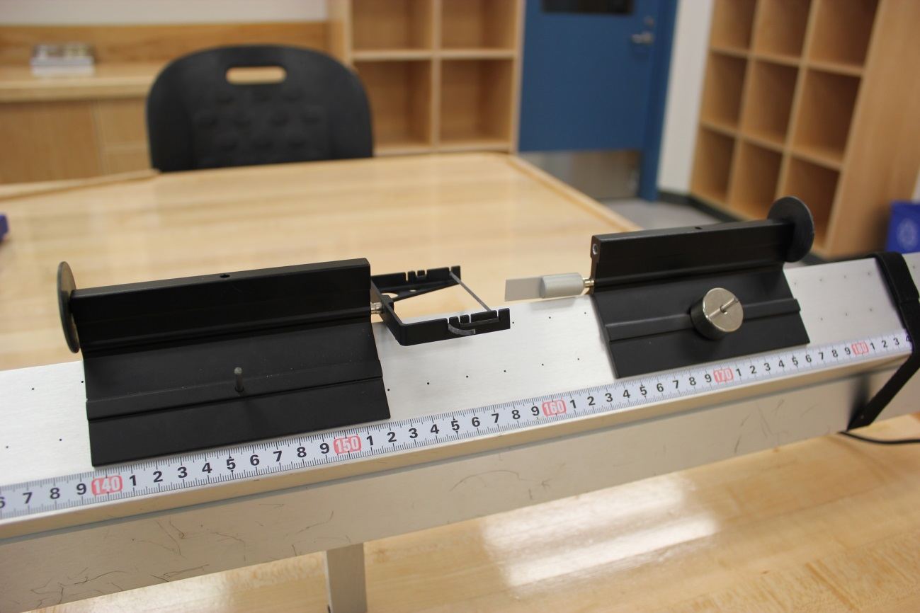
Elastic bumpers
The setup
(elastic):
Glider 2 (with extra masses)
Glider 1

Slide 7
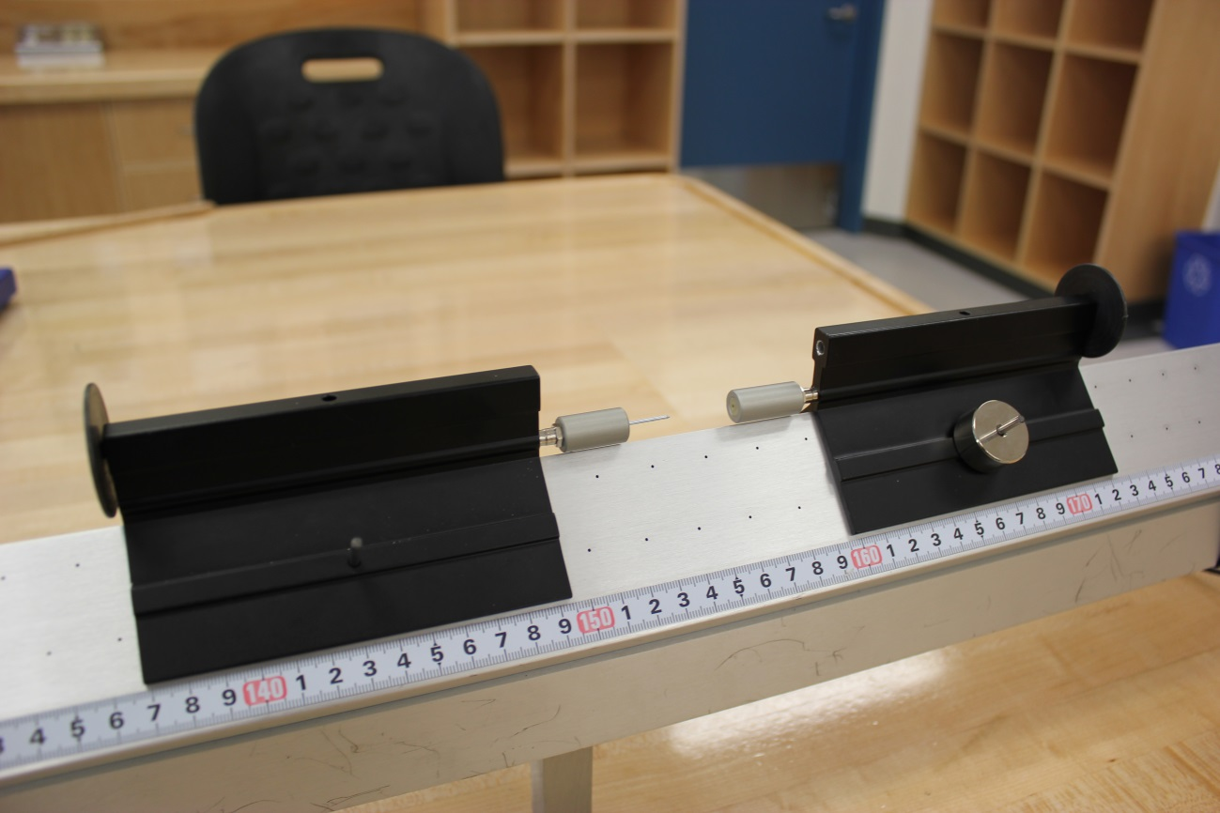
Needle and wax receptacle
The setup
(inelastic):
Glider 2 (with extra masses)
Glider 1

Slide 8
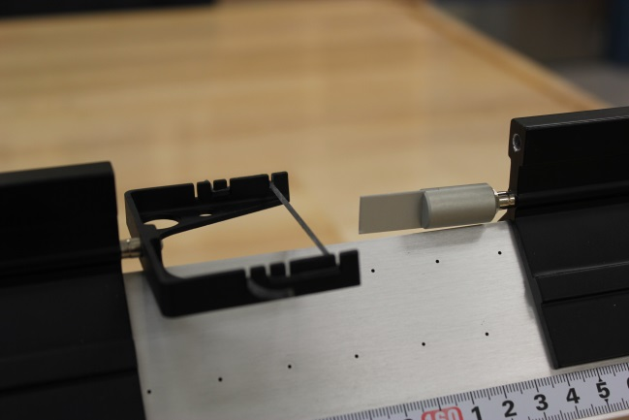
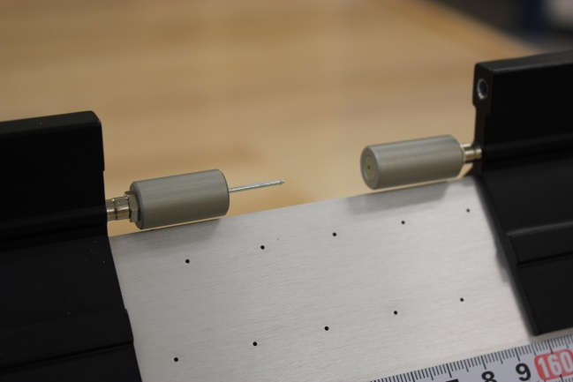
The setup
Closer view of the elastic bumpers:
Motion detector setup:
Closer view of the needle and the wax receptacle:

Slide 9
PRELIMINARY TASKS
Launch Logger Pro, turn on air supply (note, you are sharing the supply!), adjust the air flow.
Level your track using the adjustable legs.
Make sure the velcro stoppers are firmly held about 10 cm from each motion detector.
Make sure the round discs on both gliders are facing their respective motion detector.

Slide 10
PART 1 – CENTRE OF MASS
Zero both your sensors with the gliders at the centre of the track. One detector should be set to “reverse direction”.
Using a pair of elastic bumpers, gently collide glider 1 with glider 2.
Create a column to calculate the position of the centre of mass, x_{CM}, during the collision.
Analyse the graph to determine velocities of: 1) glider 1 before the collision 2) glider 2 after the collision 3) the centre of mass before and after the collision

Slide 11
PART 2 – ELASTIC COLLISION
Using the same setup as Part 1, record data for an elastic collision (elastic bumpers).
Using position vs. time graphs, obtain the velocities of each glider before and after the collision.
Add a couple weights to glider 2 and try the collision again using two objects of different masses (light object hits heavier object)
Try the collision again but this time have the heavier object hit the lighter one.

Slide 12
Part 1 & 2 - Elastic collision

Slide 13
PART 3 – INELASTIC COLLISION
Switch to the needle and wax receptacle bumpers.
Perform a collision with two gliders of equal mass.
Make sure the gliders can travel smoothly all the way to the other end of the track without stopping after your collision.
Using position vs. time graphs, obtain the velocities of each glider before and after the collision.
Like in part 2, repeat for a lighter object hitting a heavier one and vice versa.

Slide 14
Part 3 - Inelastic collision

Slide 15
CLEAN UP!
DUE DATE
Turn off the air supply, computer, and don’t forget to take your USB key.
Put the gliders, bumpers, and weights on the table.
Please recycle scrap paper and throw away any garbage. Please leave your station as clean as you can.
Push back the monitor, keyboard, and mouse. Please push your chair back under the table.
Thank you!
The report is due at the end of the lab session, i.e., at 12:50pm or 5:20pm.
Don’t forget to do your pre-lab for the next experiment!
PRE-LAB
Notes:
Comments for TAs: leave this slide on the TV monitors when you are not using them for teaching.

